Slide 1
Flight Heaters and MLI
Phase III Flight Safety Review
12 Jan 2009

Slide 2
Heaters on AMS-02
Heaters are used on AMS-02 for a variety of purposes.
  Keep electronics boxes above minimum keep-alive temperatures while unpowered.
  Optimize thermal control system operations and preheat lines during startup.
  Thaw thermal control system tubing in case of lengthy power shutdown in cold orbit.
  Heat individual detectors to minimize thermal gradients.
Several types of heaters used.
  Majority of heaters are film-type heaters made by RICA and Minco.
  Resistor heaters used in several locations where space was available.
  Wire heaters used on Tracker Thermal Control System due to installation issues.

Slide 3
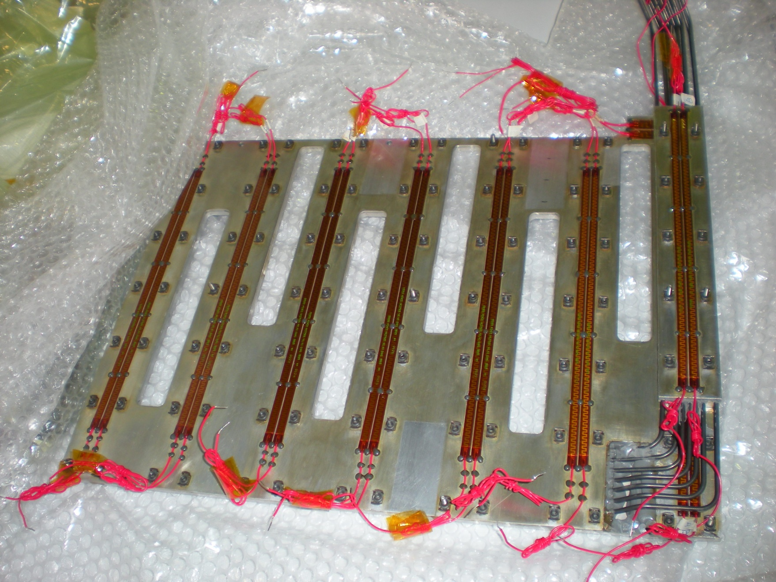
Minco Heaters on TTCS Condensor

Slide 4
Heater Safety Assessment
No safety controls require heaters to work.
  No heaters are required to operate to maintain payload safety.
  Pressure vessel MDPs assumed majority of heaters are failed on.
  Where failed-on heaters unacceptable, all circuits are protected by a minimum of three thermostats with at least one on return leg.
Loss of heater circuits can only affect mission success.

Slide 5
AMS-02 Multi-Layer Insulation
AMS-02 uses two major types of blankets
  Multi-Layer Insulation – Outer layer of Betacloth, 5-20 layers of aluminized mylar separated by Dacron scrim, and inner layer of either aluminized kapton, aluminized mylar, or Betacloth.
  Single-Layer Blankets – Single layer of Betacloth backed up by aluminized kapton.
Blankets are made by either JSC or RUAG.
Small number of blankets provided by ISS as part of GSE assemblies (PVGF, EBCS).

Slide 6
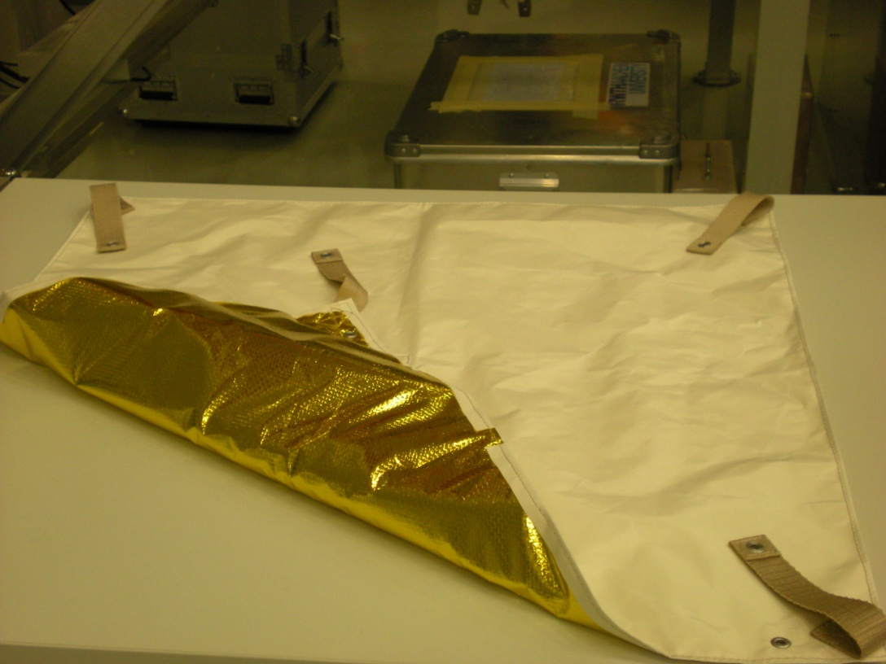
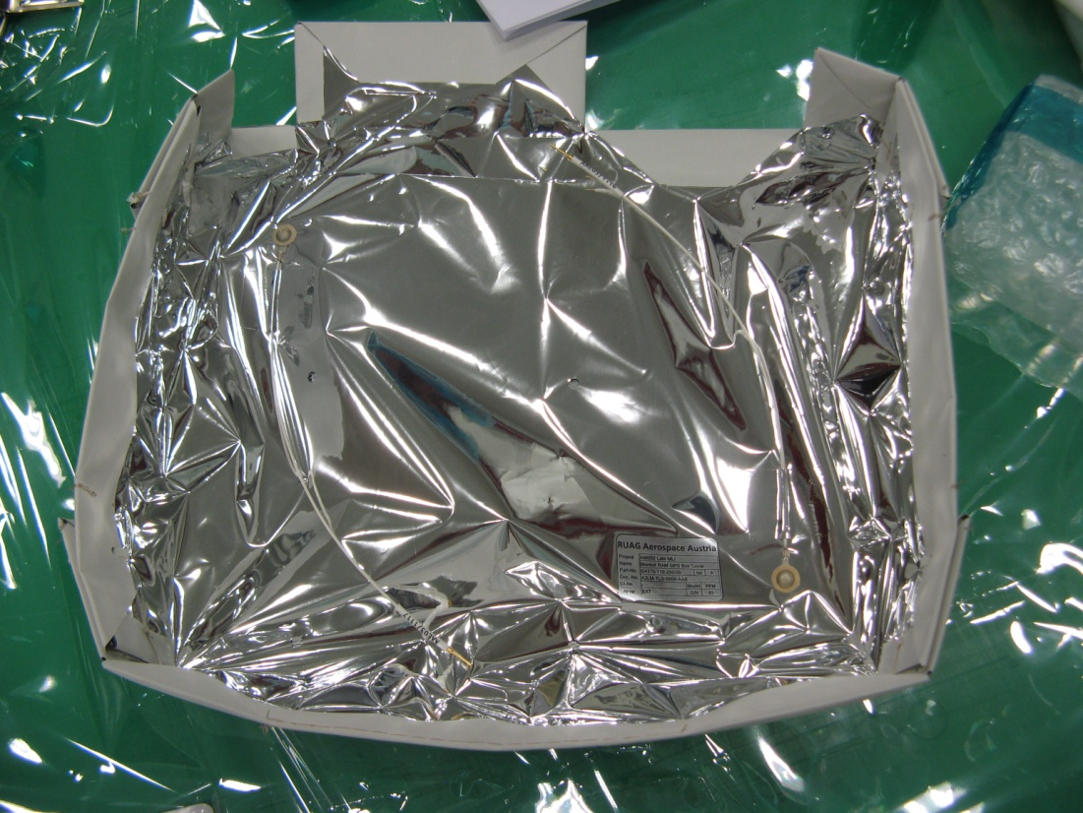
Sample AMS-02 MLI Blankets
JSC-built MLI
RUAG-built MLI

Slide 7
Ground Heater Fire
On November 24th, AMS-02 was performing a routine tank refilling operation.
At ~1700, smoke was observed coming from under the thermal blankets on the Vacuum Case Upper Support Ring. Flames appeared within sixty seconds and fire control began immediately.
No one was hurt during the incident and all CERN safety protocols were met.
  Non-essential personnel were evacuated from the clean room.
  All magnet external power was cut.
  Flames were put out with a CO2 fire extinguisher.
  Magnet cryogenic systems were monitored throughout.
Cause was traced to a GSE heater used to prevent icing.

Slide 8
Icing of Cryogenic Lines
During cryogenic operations, certain locations have been found to be prone to ice buildup.
Several techniques have been tried to prevent or eliminate this buildup.
  Heat guns, either hand-held or mounted on stands, pointing at the affected area.
  Adding GSE heaters pointing at affected area.
    When pipework exposed, these were ground heaters which could be removed.
    After MLI installation, these were flight-like heaters whose wires would be cut but which would fly.
  Building reinforced Kapton ductwork to direct airflow to affected areas.

Slide 9
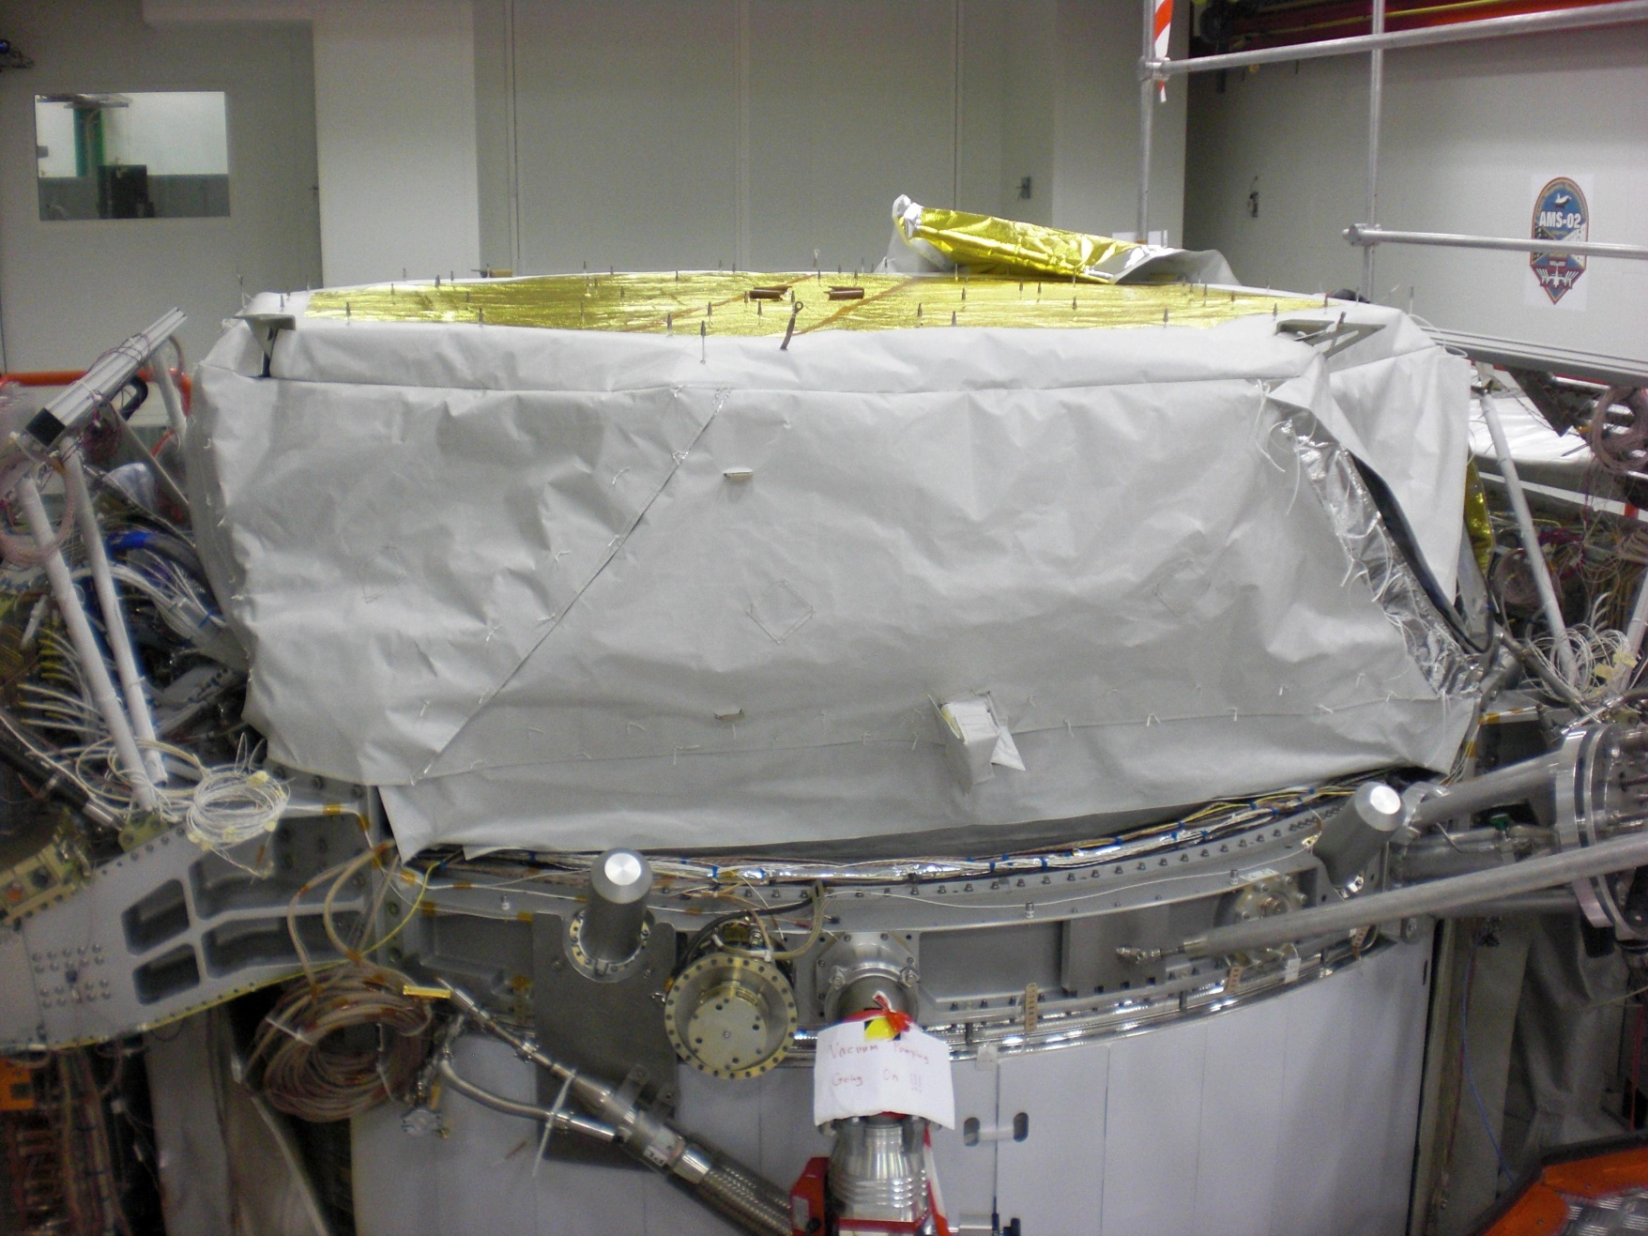
Ground Heater Location

Slide 10
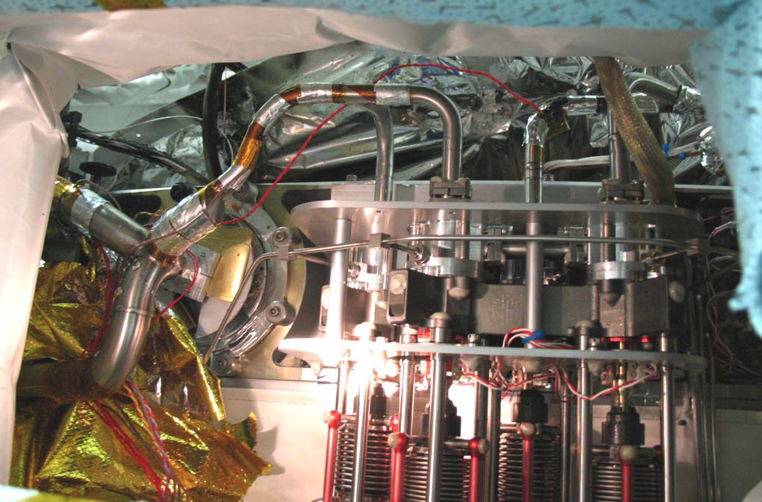
Ground Heater Installation

Slide 11
Damage Assessment
Inspections revealed some areas of damage.
  Two flight wire bundles were damaged by fire.
  Three MLI blankets were damaged by fire, and one was cut open during firefighting operations.
  One GSE heater was severely scorched.
Remainder of system appeared unaffected.
  Soot-covered areas wiped clean with little effort.
  Pipes did not get hot enough to damage 316L tubing.
  Nearby sealing surfaces rechecked for leaks with no problems found.

Slide 12
Ground Heater Installation
After post-fire inspection, several issues were identified with GSE heater installation.
  Heaters were wrapped around 90-degree bend in thin pipe.
  Aluminum tape only used to cover ends, not to cover entire heater.
  Heaters were on two cryogenic lines, but only used one thermister.
  Work was not done with proper documentation.

Slide 13
Corrective Action
Damaged wire bundles were removed and replaced with flight spares.
Damaged MLI blankets were removed and will be replaced at ESTEC or KSC.
All GSE heaters have been removed. Future de-icing will be done solely with heat guns and ductwork.
All work done during November is being reinspected.
Installation techniques for similar flight heaters reviewed.
All physicists, engineers, and technicians have been retrained on proper review and inspection procedures.

Slide 14
Flight Heaters
Some flight heaters are of similar design to failed GSE heater, but design and installation process is different.
  Heater power lines designed to prevent heaters from exceeding power density limits.
  Flight heaters installed exclusively on flat surfaces using rollers to ensure good contact.
  Flight heaters also covered by layer of aluminum tape to prevent localized hot-spots.
  Flight heaters quality inspected to confirm all procedures followed (see anomaly AMS-02-A18).
Only flight heaters installed on curved surface are wire heaters designed for that purpose and foil heaters potted with RTV to ensure good thermal connection.
Flight heaters and installation procedure are standard processes used on most ESA hardware.

Slide 15
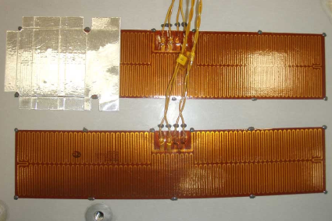
Flight Heaters During Installation

Slide 16
Conclusion
GSE heater fire caused by installation mistakes and does not reflect systemic problem with AMS-02 heaters.
Full details of the flight heaters and the MLI are given in the Safety Data Package.
  MLI details given in section 5.13.2
  Heater details given in section 5.13.3 and Appendix B.
  General heater safety discussed in Cause 8 of Hazard Report #5
  Flammability issues discussed in Hazard Report #10

