Slide 1
Large Helium Refrigeration
Oil Flooded Screw Compressors
04/05/2015

Slide 2
Warm Compression Station Overview
The warm compression system is used to compress pure helium from 1,05 bar abs to around 20 bars, and is composed of :
Pressure Control Panel
Typical WCS:
x LP Compressors
x HP Compressors
An Oil Removal System (coalescers + charcoal tower)
A Pressure Control Panel
Option :
a sub atmospheric stage (VLP->LP)
a dryer after coalescers.
only a single stage (3,4 bar -> 20 bars) instead of LP & HP
~20 bar abs,
[oil] = 100 ppm
~4 bar abs
ORS
1,05 bar abs
HP
LP
,[oil] < 10 ppb
Refrigerator

Slide 3
Input Data
In the next months we will have to work on multiple refrigerator/liquefiers :
4 plants 10kW @ 4,5K eq.
2 plants below 5 kW @ 4,5K eq.
1 plant 25kW@ 4,5K eq.
1 plant of 35kW@ 15K
The table below gives a quick estimation of the potential required flow

Slide 4
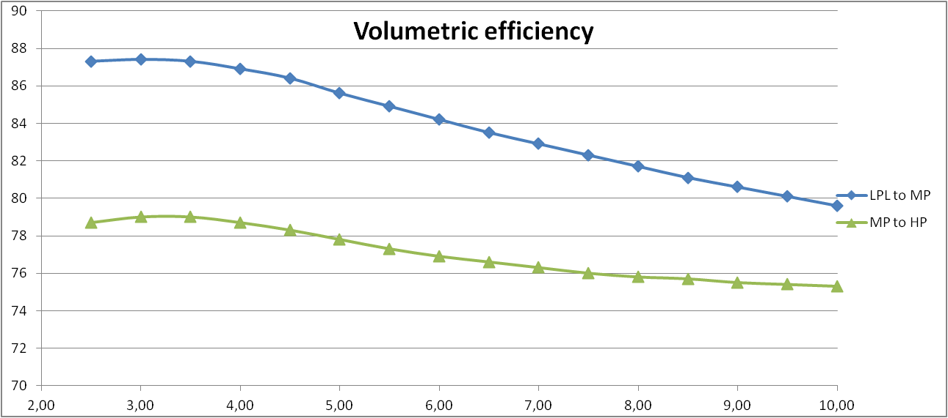
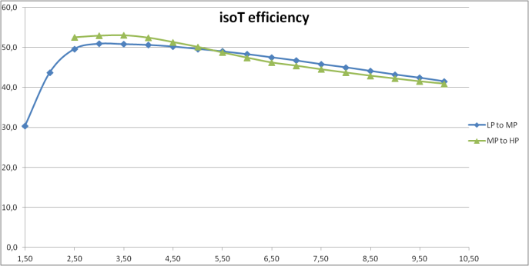
Process Optimization / Screws Selection
In order to optimize the number of compressors and the associated power consumption, we need to be able to select accurately the screws.
Today : We supply a process datasheet and try to fits vendors screws to it.
Tomorrow: We want to pre-select efficiently the screws and converge our process to them.
To develop an efficient process, we need:
The capacity of helium screw displacement
Their volumetric efficiency (as the example)
The isothermal efficiency
The maximum delta P for each screw size.
Example of volumetric efficiency evolution VS pressure ratio
Example of Isothermal efficiency evolution VS pressure ratio

Slide 5
Cost Reduction / Package Optimisation
We intend to systematize the compressor package and be as close as possible to a standard equipment.
We would like to review with you all majors requests that impact the cost and clarify accordingly our specification.

Slide 6
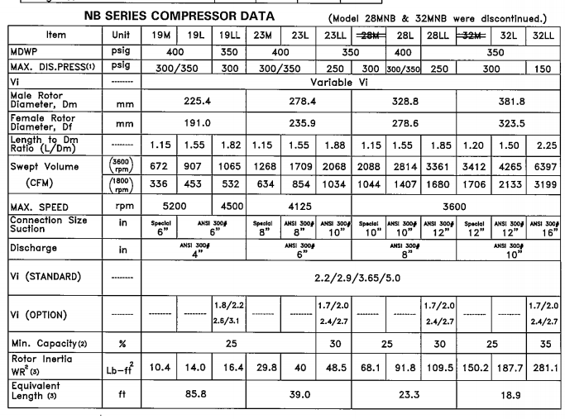
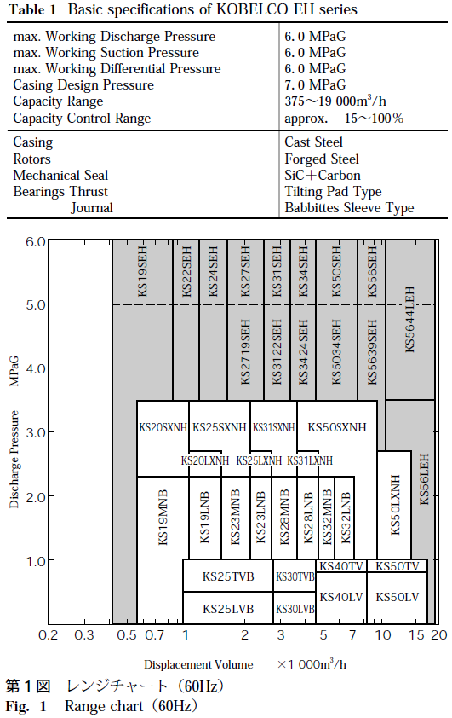
Cost Reduction / Package Optimisation

