Slide 1
G&C Large Helium refrigerators
Increasing Competitiveness and profit
DESIGN TO COST – Kick-off meeting
6/3/2015l Pierre Roux Air Liquide Advanced Technologies
THIS DOCUMENT IS CONFIDENTIAL

Slide 2
What is at stakes ? | Introduction to the project | N. Blanchard
Market & Opportunities | Our customers Market size, Business perspectives Competition Customers selection criteria | P. Dauguet
Product & Solutions | Competition survey & Technology road map | JM. Bernhardt
 | Large He plants types | V. Héloin
 | Solutions to business perspectives Functionnal needs Scope Size and main features | V. Héloin
Project | Main objectives : CAPEX, OPEX, Lead time | P. Roux
 | Baseline : scope and cost breakdown
 | Organisation & Governance
 | Planning & Resources
DTC | Methodology | C. Koffi

Slide 3
What is as stakes ?
ESS – AL CONFIDENTIAL

Slide 4
What is at stakes ?
  Business background
  → 2000-2014 : 340 M€ Large projects
  → 2015-2018 : 150 M€ Large projects to win
  Catch more business
  → Win more than 60% of the next large projects
  Increase profitability of won projects

Slide 5
  Main issues to be adressed
  What can be improved to increase the competitiveness of our offer ?
    DTC
  What breakthrough technologies can be explored ?
    Technology road map
  Competition survey, Commercial approach & networking

Slide 6
MARKET
ESS – AL CONFIDENTIAL

Slide 7
Who are our customers ?
Large Instrument for Physic Research (LI): includes colliders, light sources (synchrotrons, cyclotrons, LINAC, xfel)
Neutron Sources and Nuclear Waste mgt (NR): Cold Neutrons Source, Spallation Neutron Source and Nuclear Waste management (TRF and ADS)
Physic Laboratories (PL): university, institute, laboratory with multiple users on the same site using liquid helium and dispatching it to local user. Generally using helium recovery systems.
Gas Industry (GI): Industrial gases and natural gases industries
Medical Instrument Manufacturer (MI): manufacturer of IRM
Space Industry (SI): includes need for ground space (LH2 for fuelling, re-liquefaction of boil-off) and test facilities (test simulation chambers)
Nuclear Fusion Research (NF): for fusion projects

Slide 8
Market Size [2000-2014]
Number of equipment sold (2000 -2014) | 218 | From ~400 k€ up to 85M€ (ITER)
Order intake (2000 -2014) | ~ 650 M€ | Not including CERN but including ITER
40%
25%
Notes:
< 20K

Slide 9
Market by customer applications [2000-2014]
Large
Ref.
Large Liq.
Large Ref.
Large Ref.
Incl. LH2
Large Liq.
Large Ref.
Notes:
Predominance de large instrument physic research et lab dans le nbre de plants.
Volumetrie de service potentiellement importante (nbreuse petite installation cryo donc rarement équipe de maintenance presente)
(attention changer les noms de physic et nuclear research)
On voit des marché emergeant Medical insdustry, nuclear fusion, nuclear reseach

Slide 10
Market by Products [2000-2014]
< 2012
~ 50% of the market
Notes:
Decoupage en 4 :
Standard helium ref : 1/3 du marché
Standard helium liquefier: on est loin de LK
Large unit: engeerining non sur etagere (ALAT bon)
LH2: gamme qui commence a s’etablir. Projet remunerateur

Slide 11
Order intake in time [2000-2014]
ITER (85 M€)
Iwatani (11 M€)
Rasgas (12 M€)
Helison (15 M€)
JT60 (25 M€)
ESS (17 M€)
KSTAR (18 M€)
RG II (16 M€)
ITER CD (31 M€)
Notes:
Un marché d’une taille récurrent 20 à 35 m€ (avec des affaires spots importantes) reparti à 1/3 2/3

Slide 12
Competition LK / AL [2000 – 2014]
Notes:
2005-2006: LK propose un nouveau produit très abouti (en liquefaction et refrigeration)
2007-2008: AL nouvelle gamme et perte de confiance.
Ce que l’on peut egalement noter, c’est la régularité du business LindeK (un socle de 20M€ de prise de commande par an) contre une structure plus morcelée du carnet de commande ALAT.
2013: nombreuses prises de commandes pour LK
2014: faible nombre de machine pour LK

Slide 13
Win / Lost & Not seen / NoGo [2007 – 2014]
Notes:
On voit une clair decroissance des no-go et non vue.
Par contre aussi une baisse du volume d’affaire (en nombre de plant)

Slide 14
Large Helium plant (ref + liq) competition
ITER (85 M€)
JT60 (25 M€
Large Helium Liquefier (Large He): helium liquefier > 300 l/h
Large Customized Helium Refrigerator (Large HR): helium refrigerator > 1300W @ 4.5K and customized to satisfy the need of customer
Notes:
Attention à JT 60
Un marche de 170M€.

Slide 15
ALAT BP for the coming period 2014-2018

Slide 16
150 M€ Large projects to win (excl. ITER CL)
2014
2015
2016
ITER Cryolines
SLAC
Gazprom
TMCP ESS
FAIR
CERN 1
CERN 2
IBS
HIAF

Slide 17
PRODUCT
ROAD MAP TECHNO
ESS – AL CONFIDENTIAL

Slide 18
Product segmentation
Product |  | Range
Standard Helium Liquefier | LHe | < 300 l/h
Standard Helium Refrigerator | HR | < 1300 W@4.5K
Large Customized Helium Refrigerator | Large HR | 1,5-25 kW @ 4.5K
Large Helium Liquefier | Large He | 5 -20 ton/day
Hydrogen Liquefier | LH2 | 600 – 3000 l/h
Nitrogen Liquefier, Neon purifer…

Slide 19
Customer needs in 2025 ?
Competition survey
Ways to differentiate our Product from Competitors ?
Critical suppliers road map & interactions with our solutions ?

Slide 20
Customer needs in 2025
Low CAPEX plants
Flexible process load, transient modes
Very large plants
  From 25kW (Iter 3x25 kW) to more than 40 kW ?
Electrical consumption
  Increasing price included over the plant’s lifetime
  From 250 down to < 175 W/W
  (electrical consumption / refrigeration power @4K)
Operational / maintenance costs
    Total cost of ownership included over the plant’s lifetime
    Service
  Provide heat recovery

Slide 21
Competition survey
Low cost plants (Chinese competitors)
Large cryogenic compressors
Larger cryogenic turbines
(Hydrogen turbines)
…

Slide 22
What do we have in our roadmap ?
Cycle compression :
  Oil flooded screw → centrifugal compressors + power recovery
Cryogenic expanders :
  16-25 bar → 8-12 bar cycles
  Magnetic bearings + power recovery
Heat exchangers :
  High performance / small footprint
  Lower cost
Large Cold Box architecture, design and manufacturing

Slide 23
PRODUCT
ESS – AL CONFIDENTIAL

Slide 24
OVERALL FUNCTIONAL ANALYSIS

Slide 25
FUNCTIONAL ANALYSIS

Slide 26
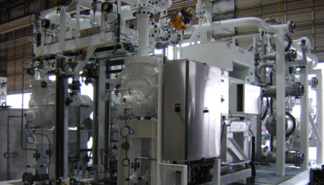
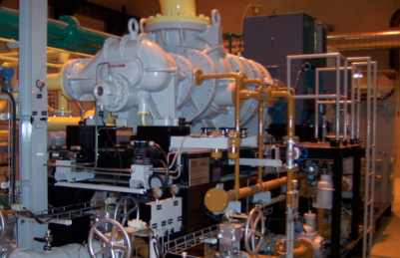
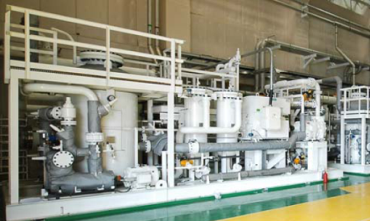
COMPRESS HELIUM
- Motors
- Screws

Slide 27
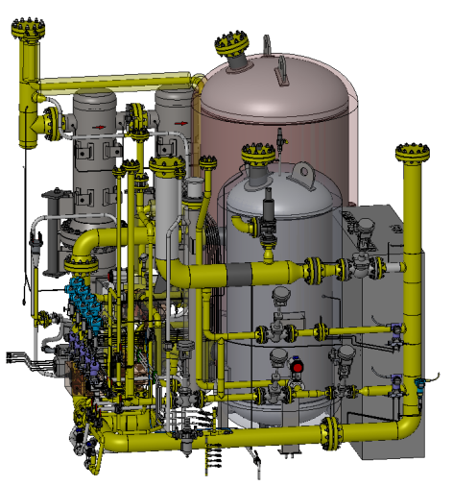
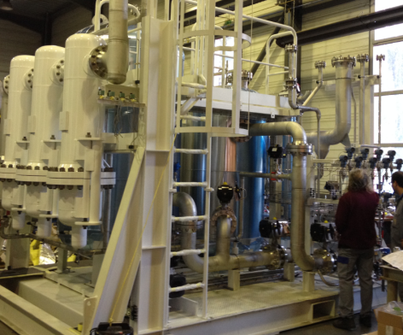
Oil Removal System (incl pressure control valves)
Charcoal Tower
Coalescers
Dryer
Control Compressors Pressures

Slide 28
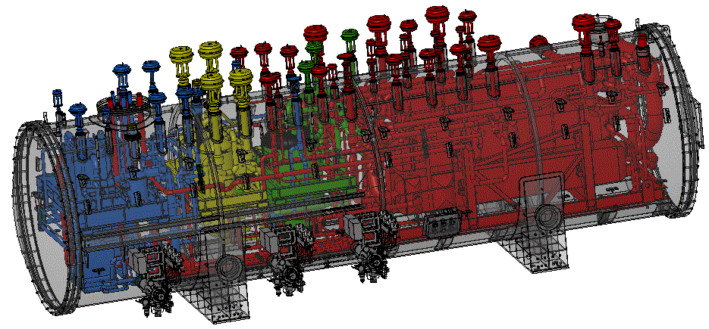
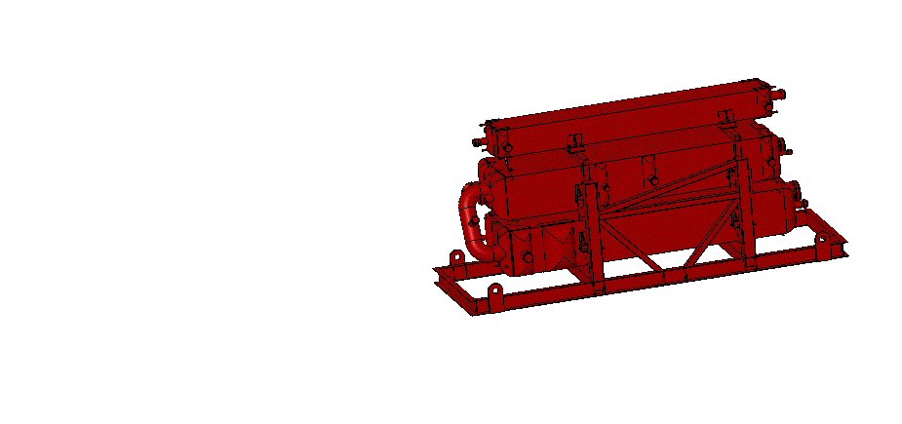
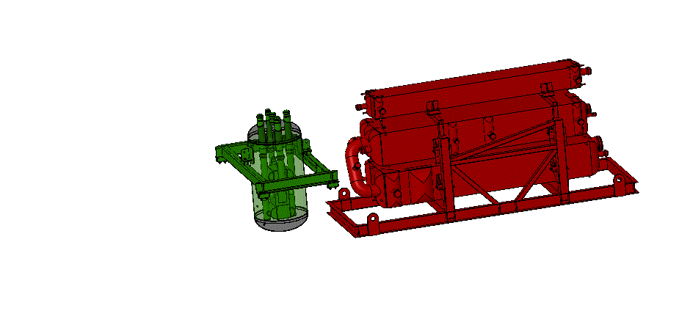
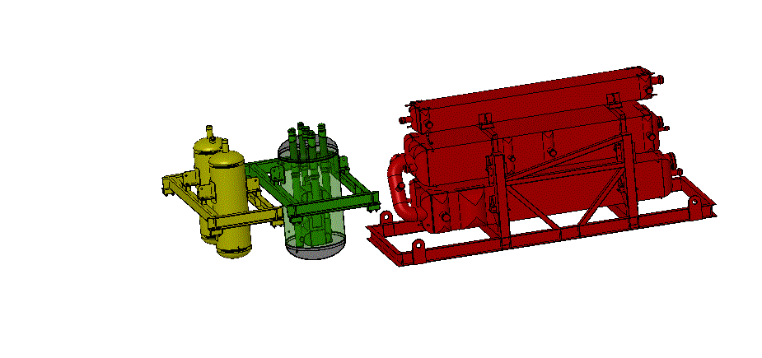
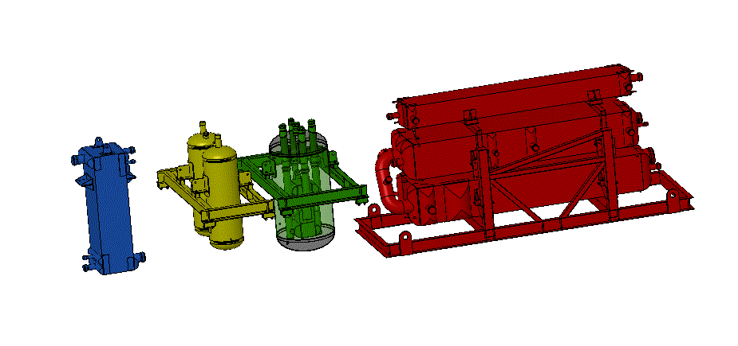

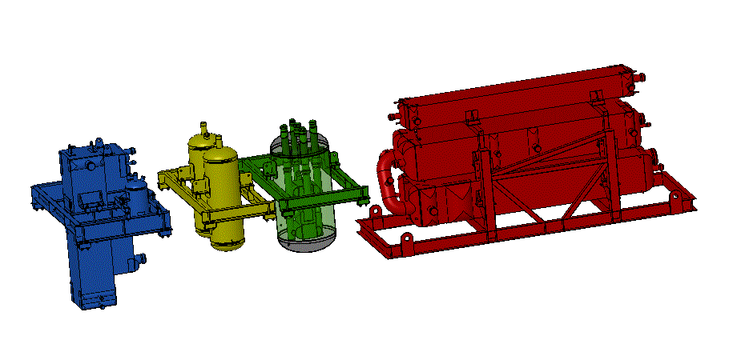
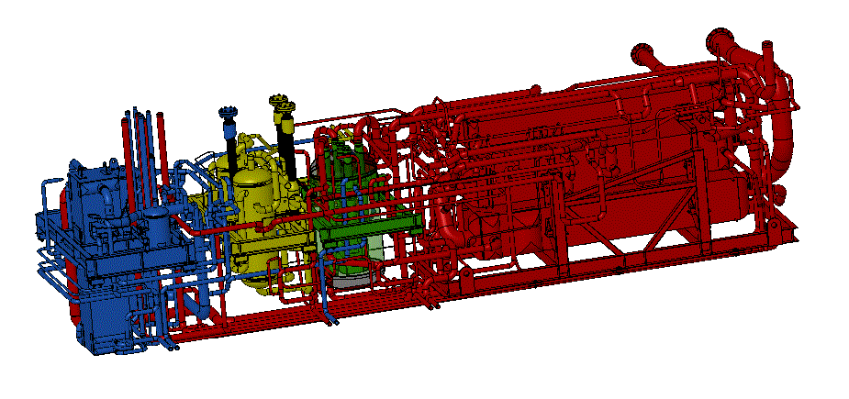
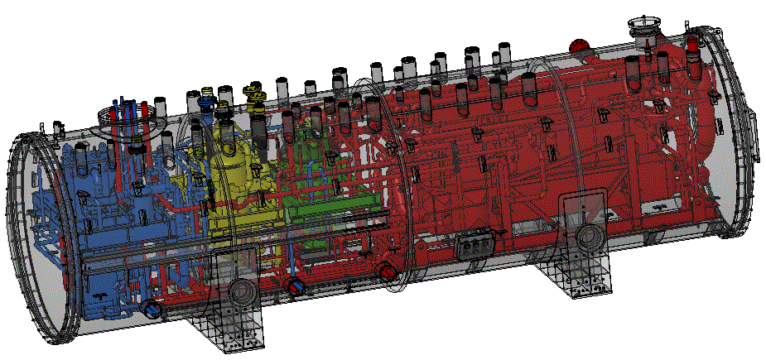
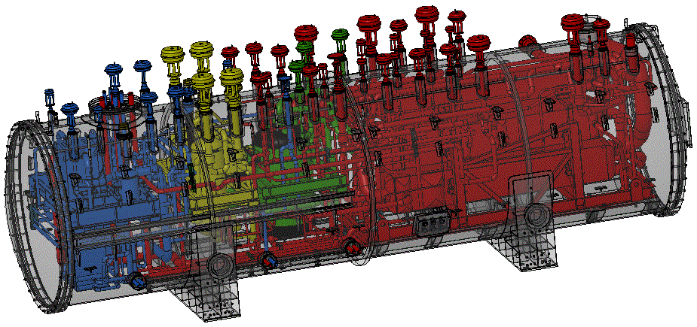
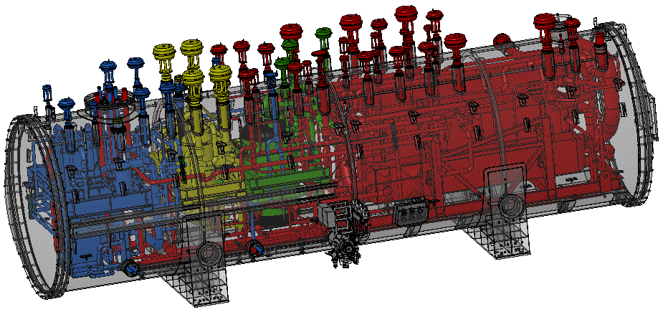

RCB Example – JT60SA
LN2 Phase Separator
(Could be replaced by 2 Turbines)
Main HX Battery
Cold HX + Ads.20K
Ads.80K
T1
T2
T3

Slide 29
LN2 Phase Separator
(Could be replaced by 2 Turbines)
Main HX Battery
Cold HX + Ads.20K
Ads.80K
T1
T2
T3

Slide 30
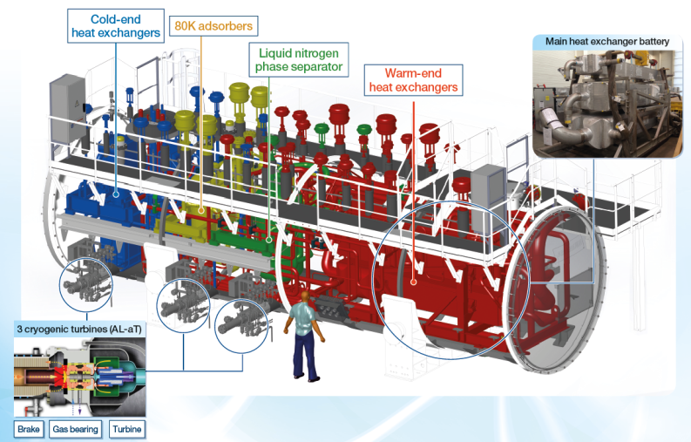
Cold Box (Ø~3m, L~12m)
LN2 precooling can be replaced by two turbines

Slide 31
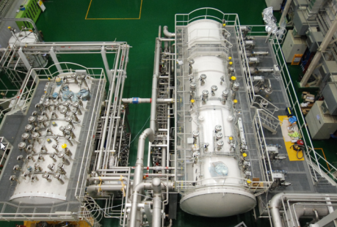
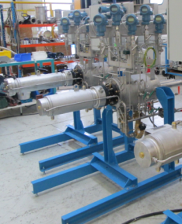
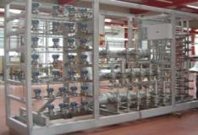
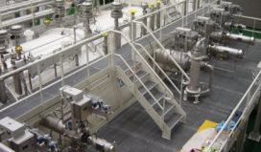
Cold Box + Distribution box
6 Turbines
Distribution box not always needed

Slide 32
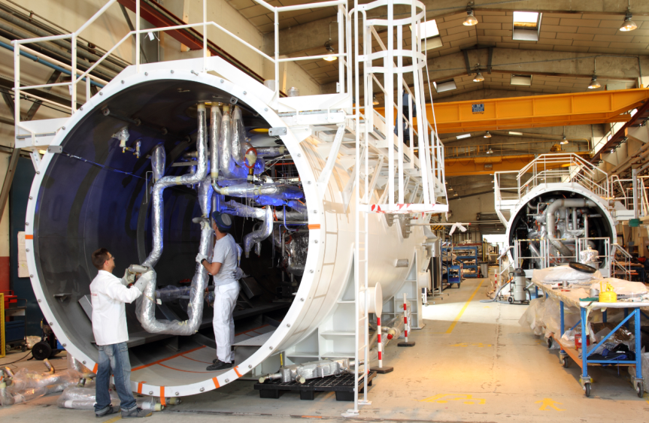
ALAT Manufacturing (Ø~3m, L~12m)

Slide 33
Projects to win : main features
Notes:
10 versus 25kW:
Turbines: combinaison de tailles existantes au catalogue TC3-TC7
Compresseurs froids : tailles existantes au catalogue
- HX : dans la gamme de nos fournisseurs FIVES / SPP , ajustement du nombre de blocs et leur taille
- Enceinte à vide : couvrir les tailles de diamètre et longueur max transportable
Méthode de Fabrication : doit prendre en compte les poids et dimensions maxi
compression chaude : couvrir toute la gamme de débit

Slide 34
Base Line
 | Temperatures | Pressure | Loads | Loads Eq @4.5K
Thermal Shields | 50K->70K (30 -> 50K ?) | 18b->17b | 35 kW | 2.5 kW (4 kW)
Liquefaction | 4.5K | 1.05b | 10 g/s | 1 kW
Refrigeration @ 4.5K | 2K | 3b->0.027b | 3 kW | 7 kW

Slide 35
Possible Process to be challenged.

Slide 36
PROJECT
ESS – AL CONFIDENTIAL

Slide 37
Customer selection criteria : ESS Rex
AL-AT |  | LINDE K
-19 (21,8 M€, +22% + option VLP 1,4 M€, +27%) | 30 points CAPEX 1 point / 100 k€ | 30 (16,9 M€ Option VLP incl.)
27 (2,60 MW, +8,8%) | 30 points OPEX (*) | 30 (2,37 MW)
28 | 40 points Qualitative | 31
Score: 36 points |  | Score: 91 points
(*) OPEX = [66 000h elec consumption] x 50€/MWh
The Key criteria is the CAPEX
+5% OPEX ~ -2 points CAPEX
Notes:
Habituellement l’OPEX n’est pas pris en compte dans l’évaluation.
On prend comme contrainte 250 à 300W/W
Customer needs :
Low CAPEX : le critère aujourd’hui prépondérant
Low TCO : tendance en occident
Low OPEX (= élec) : performance scientifique
Low OPEX (= élec+ autres utilités + maintenance)

Slide 38
Baseline scope
Equipements :
  4,5K/2K - 10kW refrigerator skid + oil screw compression station, incl. platforms and stairways
  One CB ambiant heater; one full flow drier
  Helium guard syst. for sub-atmo. parts
  Acceptance test cryostat or acceptance test equipment (heaters in the CB ?)
  Bulk cables and piping (see site services)
  He impurety detectors (CS and CB)
  PLC+ EPICS + PC + connections to central control room
  Spare parts (App.5) : bare compressor, motor, turbines cartridges, cold compressor, etc…
Option 1 : On site piping, cabling & installation (CS / CB interconnections) to the building limits
Option 2 : LHe storage tank (20m3) and transfer lines
Documentation :
  Project management, scheduling, interface and qualiy control, meetings, inspections
  Basic and detail design (App.4 §1.7)
  Site services (App4 §1.5):
  Unloading / lifting/ placing at final place
  Cabling and piping between compr.and bulk items, ORS + between CB skids, WP, PLC
  Supervision of ESS installation works, commissioning & start-up, training
Delivery time : 28 Months DAP + one year installation and commissioning

Slide 39
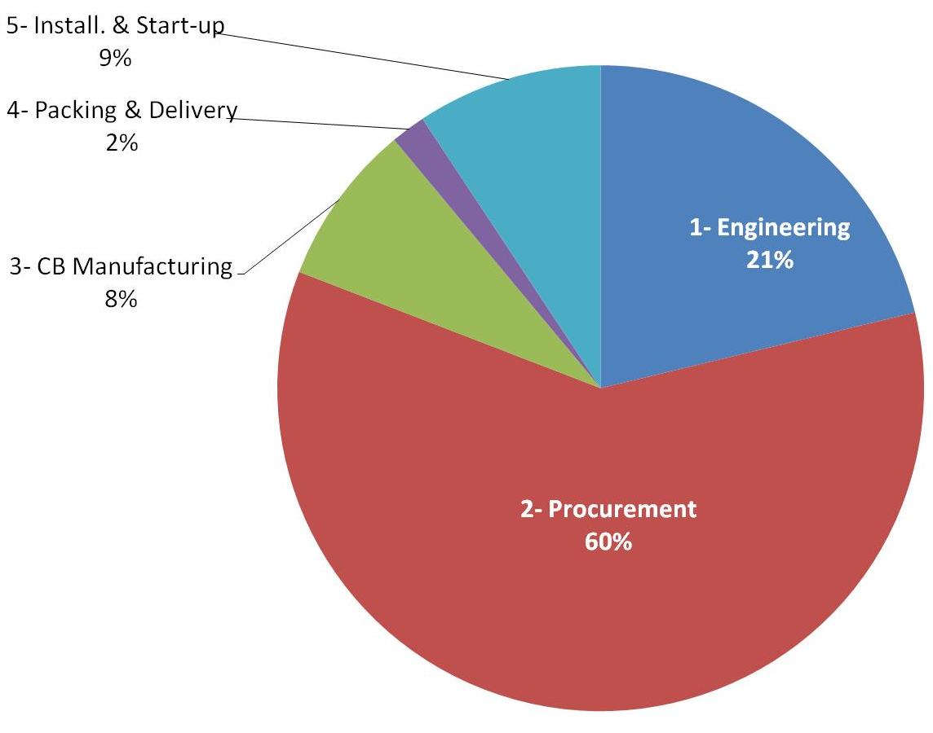
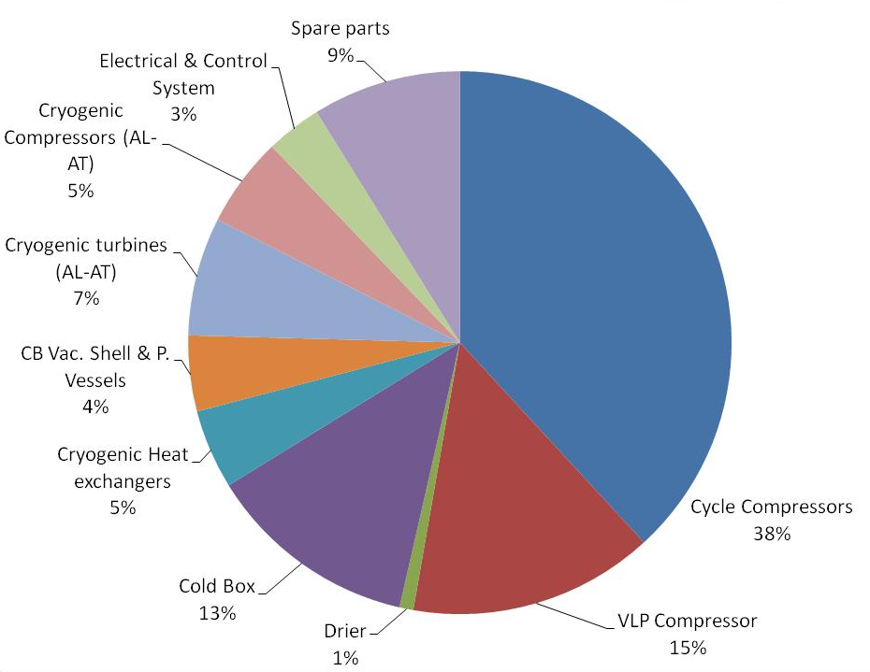
Baseline Cost breakdown

Slide 40
Baseline Cost breakdown and Target
-38 %
Linde Price -10%

Slide 41
Baseline Cost breakdown and Target

Slide 42
Organization & Governance
Sponsor & business owner
Xavier Vigor (AL-AT Director)
Steering committee
Nicolas Blanchard (G&C BU Manager) Véronique Grabié (Design Authority) Jérôme Beauvisage (Proposition Manager) Michel Santin (Manufacturing Manager) Benoit Rossignol (Design Manager) Vincent Vonin (Procurement & Purchase Manager) Olivier de Cayeux (Procurement Performance Manager)
Validation comitee
Véronique Grabié (Design Authority) Jérôme Beauvisage (Proposition Manager) Jean Marc Bernhardt (Refrigeration Product Manager) Michel Santin (Manufacturing Manager) Benoit Rossignol (Design Manager) Vincent Vonin (Procurement & Purchase Manager)
Core Team
Pierre Roux (Project Manager ) Emmanuel Touzet (Procurement) Vincent Héloin (Product & Project Engineer) Céline Koffi (DTC Manager)
Workgroup Leader
Functional analysis Modularisation | Proposal approach Value analysis | Warm Compression, purifier & ORS | Turbo-machines | Manufacturing, site integration | Cold box & periphericals | Project strategy & management
WP1 | WP2 | WP3 | WP4 | WP5 | WP6 | WP7
Vincent Héloin | Rawia Ali Said | Vincent Héloin | Franck Delcayre | Florent Lorieau | Vincent Héloin | Pierre Roux

Slide 43
DTC Work packages & staffing
Group #1
Group #2
Group #3
Group #4
Group #5
Group #6
Group #7
Validation
Committee
Product Strategy & management
Compression & ORS & drier / purifier
Cryo Turbo Machines
Manufacturing, Delivery & Site Integration
Cold box & periphericals
Project Strategy & management
- Functional analysis,
-Modularisation
- Standards
- Proposal approach,
- Cost estimate,
- Rex,
- customer needs
- Warm Compressors & ORS,
- Drier & Purifier,
- Capital related spare parts,
- Electricals
- Turbines
- Cryo-compressors
- Capital related spare parts
- Manufacturing hours,
- Methods,
- Packing & transport,
- Installation,
- Start-up
CB Design & CB equip,.
Instrument & control
Dewar, VTL, gas bag, …
Engineering hours,
Industrial approach, FOREX
Contract management
  N. Blanchard
  J. Beauvisage
  V. Grabié
  J.M. Bernhardt
  M. Santin
  B. Rossignol
  V. Vonin
Scope
WG
Leader
  V. Héloin
  R. AliSaid
V Héloin
  F. Delcayre
  S. Crevatin
  V. Héloin
  P. Roux
  V. Heloin
  A. Machefel
  JM Bernhardt
  D. Grillot
  S. Crispel
  G. Zick
  Y. Fabre
  B. Rossignol
  C. Mantileri
  G. Gistau
  V. Grabié
  M. Santin
  F. Lagoutte
  P. Petit
  F. Janin
  J. Beauvisage
  S. Crispel
  P. Dauguet
  A. Praud
  JM.Bernhardt
  G. Gistau
  Y. Rançon
  F. Delcayre
  JM Bernhardt
  G. Flavien
  D. Grillot
  P. Roux
  S. Crevatin
  V. Grabié
E. Gauliard
F. Durand
D. Guillet
C. Mantileri
  S. Crevatin
  G. Gaillard
  R. Ali Said
  F. Bertholat
  M. Benzeghiba
  C. Mantileri
  M. Santin
  F. Lorieau
  P. Cadeau
  JL Toia
  F. Bertholat
  D. Grillot
  F. Delcayre
  G. Boye
  T. Novet
  R. Besson
  F. Lorieau
  B. Rossignol
  JM Bernhardt
  B. Rossignol
  A. Machefel
  F. Bertholat
  C. Mantileri
  V. Billot
  V. Vonin
  E. Dupasquier
  M. Santin
  A. Romano
  F. Janin
WG
Members
Procurement
E. Touze
  23 & 24/03
  24/03
  26/03
  01/04
  31/03
  25/03
  30/03

Slide 44
Role of the validation committee
Review and validate CAPEX reduction levers
  Act as a validation instance that reviews all the levers
  Provide operational feedback to work groups in order to ensure that levers can be implemented
Review CAPEX vs. OPEX trade off
  Review and validate trade off analysis between CAPEX and OPEX
  Conduct arbitrage in a rational and quantified way
Technical Validation
  Ensure the safety, operational and performance requirements are met

Slide 45
Roles of the various members
Role
Participation
Involvement
Core Team members
  Project Management
  Facilitation, coaching, staffing
  Issues analysis and reports to the SC
  Day to day
  50% – 80%
  Leads workgroup (organization, meeting scheduling, coordination)
  Facilitates decision making within workgroup
  Key interface with Core Team
  Workshops
  Validation Committee
  30% – 50%
Workgroup Leader
  Active participants responsible for idea generation, data collection, and action execution
  Workshops
  Validation Committees upon request
  20% – 30%
Workgroup Member
  Provides functional / technical expertise to workgroup members
  Acts as an advisor that can be contacted on an ad hoc basis
  Ad hoc request
  10%
Workgroup Expert

Slide 46
DTC execution planning : 3 main phases
April
May
Jun
Jul
Aug
Sep
Identify the levers
Quantify the levers
Validate the levers
    New price sheet

Slide 47
DTC Methodology

Slide 48

Design To Cost at Air Liquide
DTC is a methodology to reconsider a product in order to adapt it to the client needs, all by reducing its production and operation costs
The methodology is based on tools such as value analysis and creative brainstorming
It relies on a multifunctional team work and participants’ experience
The objective is to deliver a new product, with certain portion of innovation, to better match the client needs.
Notes:
J: Let me give you the complete definition of Design to cost…
DTC is a methodology to reconsider a product in order to adapt it to the client needs, all by reducing its production and operation costs.
The methodology is based on tools such as value analysis and creative brainstorming.
It relies on a multifunctional team work and participants’ experience.
The objective is to deliver a new product, with certain portion of innovation, to better match the client needs.
F: I think I start to understand the concept, but where does it come from? Since when it exists?

Slide 49
DTC Initiation: 3 critical elements
Justified market needs
  Market size and evolution trend
  Customer requirements
  Price/Cost objectives
Market Study
Define the referential:
  Product type
  Main features
  Cost breakdown
Baseline
Project
Governance
Setup the project organization:
  Steering Committee
  Project Manager
  Strict project management
Notes:
J: When initiating a DTC project, 3 elements are very important: The market study, the Baseline and the project Governance.
The Market Study is the starting point for any DTC.
By analyzing the market context, it will justify the need for design and cost optimization of the selected product.
It will provide the market potential, the customer needs and the target price and cost.
In order to measure the future savings, a Baseline must be defined at the very beginning of the project. Ideally, it should be based on a recently executed project. A detailed cost breakdown of this product must be setup.
Finally, a project governance structure must be implemented.
F: With those 3 pre-requisites, it seems that the project’s foundations can be solid!

Slide 50
DTC Planning Summary
2015
2016
Phase 0 – Market analysis
Jan
Fev
Mar
Apr
May
Jun
Jul
Aug
Sept
Oct
Nov
Dec
Jan
Fev
Phase I – Initiation/planning
Capitalization on REX
Functional Specifications
Baseline Pricing
Workgroups Staffing
Phase II – DTC execution
Kick-off meeting
Creative Workshops
Levers generation
Levers sorting
Levers Quantification
Validation
New Price sheet
Phase III - Implementation
Levers Implementation
First Project development
DTC Steering Committees
Workshops (at least 5 workshops for each of the 6 working groups)
DTC Kick-off meeting

Slide 51
DTC - 7 key Principles
1
Multi functional team work
  Confront the client, the specifier, the buyers and the operator
  Involve all required expertise available, including suppliers
2
Systematic challenge of the specification: no taboo
  Address all levers: functional specification, technical specification and purchasing specification optimization
  Everything can be challenged
  Use facts and experience coming from proven solutions
  Challenge preconceived ideas, taboos, habits…
3
Fact-based, quantified approach and 80/20
  Focus on levers with most economical impact
  Develop quantified reasoning to evaluate savings
4
High ambition
  Look for high economic impact solution
5
Visibility and transparency
  Facilitate trade-off decisions: risk versus cost versus performance, escalate for quick decision making
6
Rigorous and step by methodology
  Ensure fairness of the process
  Align all stakeholders on a common and fact-based approach
7
Speed
  Systematic but not exhaustive:
  Create pace, transparency and visibility
Notes:
J: When initiating a DTC project, 3 elements are very important: The market study, the Baseline and the project Governance.
The Market Study is the starting point for any DTC.
By analyzing the market context, it will justify the need for design and cost optimization of the selected product.
It will provide the market potential, the customer needs and the target price and cost.
In order to measure the future savings, a Baseline must be defined at the very beginning of the project. Ideally, it should be based on a recently executed project. A detailed cost breakdown of this product must be setup.
Finally, a project governance structure must be implemented.
F: With those 3 pre-requisites, it seems that the project’s foundations can be solid!

Slide 52
Rules for a brainstorming cession
Be open to others’ ideas, Do not criticize ideas
Encourage crazy & out of the box ideas
Forget you are expert , prefer to be a new born
Be pragmatic, good sense bring often to good ideas
Try to elaborate on ideas from others, jump to more new ideas
Quantity not quality

Slide 53
DTC Methodology
Creative Workshops & Prioritization
Lever Sheets Elaboration
Levers Validation
Kick Off
Workshop 1
Workshop 2
Workshop 3 & 4
Validation meetings
  Validation of scope
  WS calendar,
  Review of the equipments in the baseline
  Target review
  Assess current situation
  Discuss cost base
  Benchmark best practices & competitors
  Exhaustive Brainstorming on saving opportunities
  Complete levers long list
  Rank levers by priority level
  Short list the levers
  Identify Levers owner
  CAPEX savings estimation (rational to be provided)
  Identification of risks and constraints
  Pre-requirements
  Road map for the implementation of each lever
  Review levers template:
  Operational requirements
  Gains estimation
  Technical feasibility
  Customer acceptability
  Risks and mitigation measures
Workgroup deliverables
  INTERNAL
  SUPPLIERS
Shared objectives
Long list of levers
Short list of levers
Lever template completed
Lever template validated
Ideas evolution
Identified ideas
Confirmed ideas
Validated ideas

Slide 54
DTC Methodology
Creative Workshops & Prioritization
Lever Sheets Elaboration
Levers Validation
Cost Reducing Ideas
Value Enhancing Ideas
Reduce the number of components
Combine components
Eliminate redundant or unnecessary components
Simpler assembly process or sequence
Relaxed tolerances or dimensions
Less expensive materials
More efficient manufacturing
Less expensive finishes
Use alternative transportation methods
Use standardized or bought-out rather than specialized components
Standardized dimensions
Duplicated components
Procurement approach: LCC, Frame Agreement, Competitive bidding
Utility: Increase capacity, power, accuracy, flexibility
Human Factors : Increase ease of use, intuitiveness
Reliability & Maintainability:
  Limited or no maintenance
  Reduce susceptibility to environmental conditions
  Reduce risk and severity of malfunction
  Increased lifetime
Safety:
  Risk free operation
  Protection from injury
Environment:
  Little or no undesirable by-products (e.g., chemical, noise, heat)
  Recyclability or reusability
Aesthetics:
  Enhanced appearance
  Improved visual and tactile finish

Slide 55
DTC Methodology
Creative Workshops & Prioritization
Lever Sheets Elaboration
Levers Validation
Prioritization based on Pain/Gain analysis
If constraints risks can be reduced, the lever is probably attractive
GAIN - Attractiveness (savings, efficiency, reliability)
"Low hanging fruits"
  Very attractive levers (not only savings, but improved technology etc …)
"Constraints to be mitigated"
  Highly attractive and usually linked to big savings but …
  … high constraints
  Work required to find trade offs and mitigates
"Low hanging fruits"
"Constraints to be mitigated"
Lever 2
Lever 1
"Quick Wins"
"Levers to be dropped"
"Quick Wins"
  Quickly identify
  Easy to implement
  No, major constraint
  Usually low potential
Lever 4
"Levers to be dropped"
  High risks/constraints for little reward
  Not worth the effort
Lever 5
Lever 6
Lever 3
PAIN- Constraints/Risk
Legend: size of proportional to savings

Slide 56
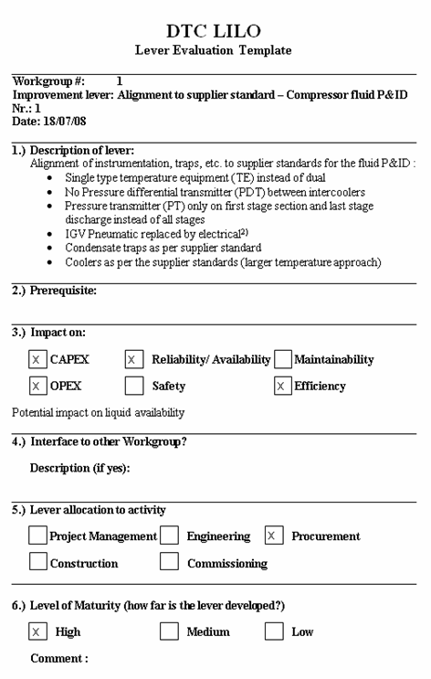
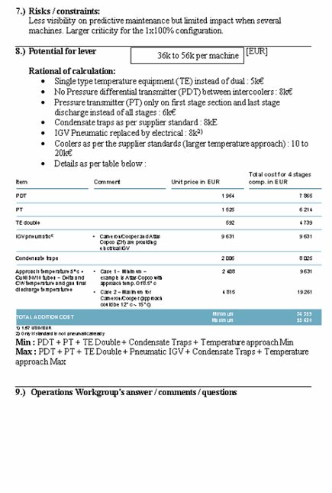
DTC Methodology
Creative Workshops & Prioritization
Lever Sheets Elaboration
Levers Validation
Lever Sheet - Illustrative
Idea is described into a detailed lever sheet
  All the workgroups submitted a detailed "Lever Template" including the following information :
    Lever description
    Prerequisites needed for implementation
    Impact : CAPEX, OPEX, reliability, maintainability, etc.
    Interfaces to other Workgroups
    Maturity
    Risks and Constraints
    CAPEX Savings estimate (value and estimation methodology)
  During the review, each lever was allocated to one of the following categories :
    Accepted
    Rejected (incl. rational for it)
    Pending (incl. tasks to be performed to gain acceptance)

Slide 57
DTC Methodology
Creative Workshops & Prioritization
Lever Sheets Elaboration
Levers Validation
Ensure operational requirements are met
Review and validate CAPEX reduction levers
  Anticipate & prioritize operational requirements from subsidiaries
  Act as a validation instance that reviews all the levers
  Provide operational feedback to work groups in order to ensure levers' implementability
Validation Committee
Technical Validation
Review CAPEX vs. OPEX trade off
  Ensure the safety and performance requirements are met
  Review and validate trade off analysis between CAPEX and OPEX
  Conduct arbitrage in a rational and quantified way
Lever validation role
Operational requirements formalization role

Slide 58
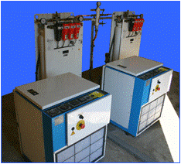
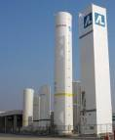
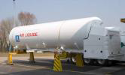
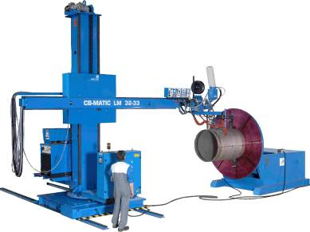
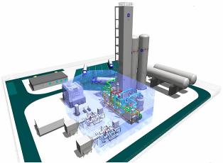
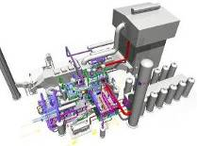
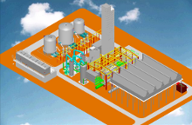

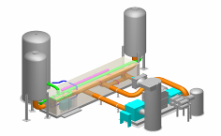
Previous DTC Projects & Ambition
The ambition is that our major products, new or existing, should go through the DTC methodology
Medical Air
ALSF
Nitrogen Platform
Food Freezer
CLAIRE Trailer
Mid-Size Standard SMR
IM
CRYOLOR
Welding Columns
LILO
Large Standard SMR
EL – E&C
Mid-Size ASU
LI – E&C Lurgi
Large Modular ASU
EOX
Storage Tank
ALW
LI – E&C Lurgi
IM – E&C
LI – E&C
IM – E&CCSP
CRYOLOR
2013
LI – E&C Cryo
2008
2012
2009
2010
2011
Notes:
J: Since Design To Cost has been implemented in Air Liquid as part of Alma Program, several projects have been successfully executed in various business lines and entities.
F: Actually, I see almost all business units have been involved.
J: Yes, and the type of the products are also very various. It is possible to apply DTC to an air separation unit delivering up to 3000 tons per day oxygen, and as well on a smaller equipment such as a cryogenic tank.

Slide 59
Back-up

Slide 60
Baseline : ESS project
Project base : ESS, Sweden, 10kW@4K
AL-AT proposed price : 23,2 M€ (=21,8 M€ base + 1,4 M€ option vacuum compressor instead 12 vacuum pumps)
Linde proposed price : 16,9 M€
Price breakdown :
Technical cost : 19,3 M€
Bid (1,7% of sales) : 0,4 M€
Contingencies (5% of sales): 1 M€
Overheads (8% of sales) : 1,8 M€
Commercial margin (3% of sales) : 0,7 M€

Slide 61
40 points qualitative details
AL-AT |  | LINDE K
2 | 3 : completeness of proposal doc | 2
1 | 2 : conformity to commercial terms and conditions | 1
2 | 4 : understanding and compliance to tech. spec | 3
3 | 4 : simplicity of layout | 4
3 | 3 : option 1 technical and organisational approach | 3
2 | 2 : option 2 technical solution | 2
0 | 4 : additionnal features | 0
4 | 4 : availability | 4
4 | 5 : soundness of control strategy | 4
3 | 4 : recovery time | 3
2 | 3 : liquefaction rate | 3
2 | 2 : response time during warrantee period | 2
Score: 28 points |  | Score : 31 points

Slide 62
Cost cutting target
ALAT price to be 5% less than Linde price (16,92M€) with 10% overheads and 5% commercial margin.
Sales price = 16,92 M€ -5% = 16,1 M€
AL-AT Technical cost + bid + contingencies = 13,7 M€
Cost cutting = 20,8-13,7 M€ = 7,1 M€ = -34%

Slide 63
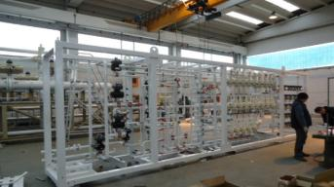
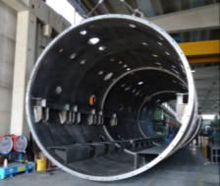
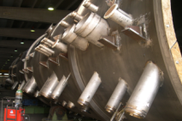
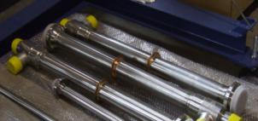
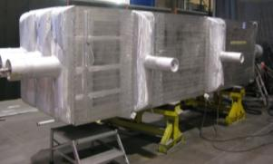
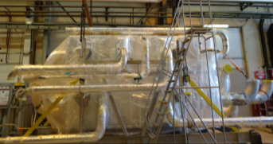
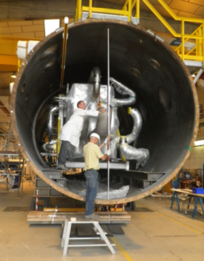
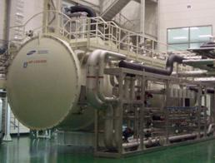
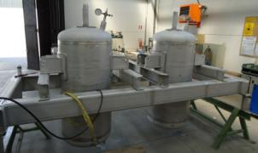
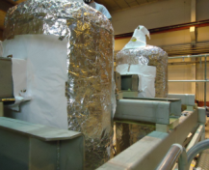
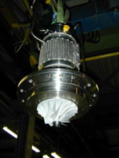
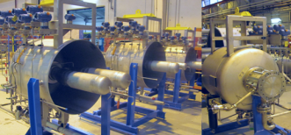
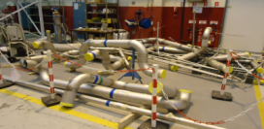
Cold Box
WP
Vacuum shell
cryovalves
Insulation / Piping
HX
CB integration
Adsorbers
insulation
Cold compr.
Piping isos
Turbines
19/03/2015
ESS – AL CONFIDENTIAL

Slide 64
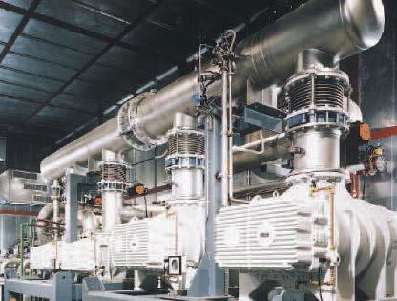
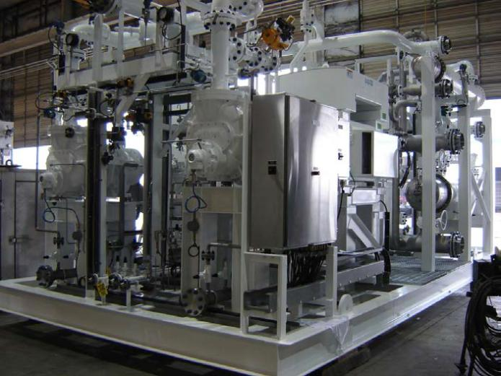
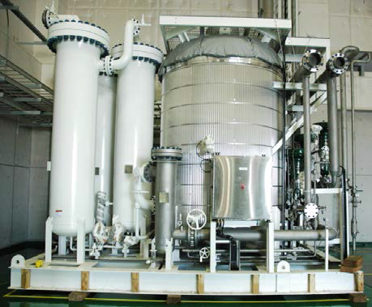
Compression skids
VLP Compressor
LP/MP/HP Compressor
ORS
19/03/2015
ESS – AL CONFIDENTIAL

Slide 65
Less than 10 M€ product market
Notes:
Helial, Hylial, ….not in the scope of our study

Slide 66
Linde Kryotechnik
Declaration Linde K 2005 (nb of people)
Administration | 10
CERN | 7
DESY | 1
Customer service / Spare part | 10
Engineering | 10
Innovation | 1
Logistic/Procurement | 4
Machinery / Worshop | 9
Management | 3
Process | 10
Project Management | 7
Quality Management | 2
Sales & Marketing | 4
Total nb of people at Linde K (2005) | 78
Service= 11 pers.
Notes:
A Pfungen (Suisse) pas d’ateliers autres que turbine

Slide 67
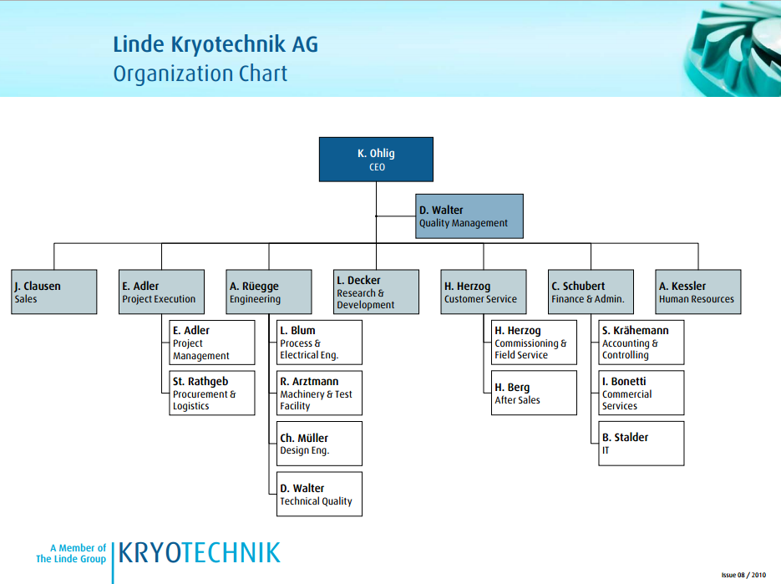

Slide 68


Slide 69
First project to win
TMCP (ESS #2) : Bid 07-09 / 2015
Solution main features:
Target price :
Timing :
    Bid : June to September 2015
    Award : October 2015

Slide 70
DTC Work packages & staffing
Costs are excluding contingencies, Insurance, overheads and commercial margin
  0,4 M€ (2%)
  7,1 M€ (36%)
  1,7 M€ (9%)
  3,7M€ (19%)
  2,7M€ (14%)
  4 M€ (20%)
Group #1
Group #2
Group #3
Group #4
Group #5
Group #6
Group #7
Validation
Committee
Product Strategy & management
Product Strategy & management
- Proposal approach,
- Cost estimate,
- Rex,
- Value analysis (customer needs)
Compression & ORS & drier / purifier
Cryo Turbo Machines
Manufacturing, Delivery & Site Integration
Cold box & periphericals
Project Strategy & management
- Functional analysis,
-Modularisation
- Standards
- Warm Compressors & ORS,
- Drier & Purifier,
- Capital related spare parts,
- Electricals
- Turbines
- Cryo-compressors
- Capital related spare parts
- Manufacturing hours,
- Methods,
- Packing & transport,
- Installation,
- Start-up
CB Design & CB equip,.
Instrument & control
Dewar, VTL, gas bag, …
Engineering hours,
Industrial approach, FOREX
Contract management
  N. Blanchard
  J. Beauvisage
  V. Grabié
  J.M. Bernhardt
  M. Santin
  B. Rossignol
  V. Vonin
Scope
WG
Leader
  V. Héloin
  R. AliSaid
V Héloin
  F. Delcayre
  S. Crevatin
  V. Héloin
  P. Roux
  V. Heloin
  A. Machefel
  JM Bernhardt
  D. Grillot
  S. Crispel
  G. Zick
  Y. Fabre
  B. Rossignol
  C. Mantileri
  G. Gistau
  V. Grabié
  M. Santin
  F. Lagoutte
  P. Petit ?
  J. Beauvisage
  S. Crispel
  P. Dauguet
  A. Praud
  JM.Bernhardt
  G. Gistau
  Y. Rançon
  F. Delcayre
  JM Bernhardt
  G. Flavien
  D. Grillot
  P. Roux
  S. Crevatin
  V. Grabié
E. Gauliard
F. Durand
D. Guillet
C. Mantileri
  S. Crevatin
  G. Gaillard
  R. Ali Said
  F. Bertholat
  M. Benzeghiba
  C. Mantileri
  M. Santin
  F. Lorieau
  P. Cadeau
  JL Toia
  F. Bertholat
  D. Grillot
  F. Delcayre
  G. Boye
  T. Novet
  R. Besson
  F. Lorieau
  B. Rossignol
  JM Bernhardt
  B. Rossignol
  A. Machefel
  F. Bertholat
  C. Mantileri
  V. Billot
  V. Vonin
  E. Dupasquier
  M. Santin
  A. Romano
WG
Members
Procurement
E. Touze
  23 & 24/03
  24/03
  26/03
  01/04
  31/03
  25/03
  30/03

