Slide 1

The ESS Cryogenics System
J. G. Weisend II, P. Arnold, J Fydrych,
W. Hees, J. Jurns, A. Lundmark, X. T. Su, X.L. Wang
June 2015

Slide 2
Outline
Introduction to ESS
Applications of Cryogenics at ESS
  Accelerator Cryoplant
  Cryogenic Distribution System
  Target Moderator Cryoplant
  Test and Instruments Cryoplant
He Recovery and Storage
Energy Recovery
Summary

Slide 3
Introduction to ESS
The goal of ESS is to provide a spallation based neutron source significantly more powerful than existing sources: 30 - 100 times brighter than ILL and 5 times more powerful than SNS
This facility will enable neutron based research in a wide range of fields including: materials science, condensed matter and biomedical studies

Slide 4
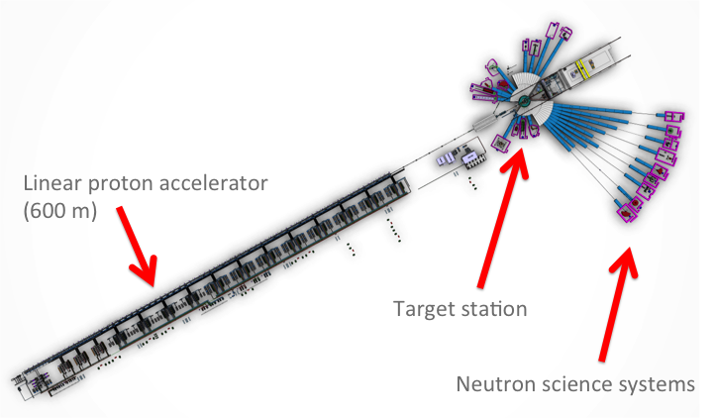
ESS Overview
5 Times more powerful than SNS
30 - 100 times brighter than ILL

Slide 5
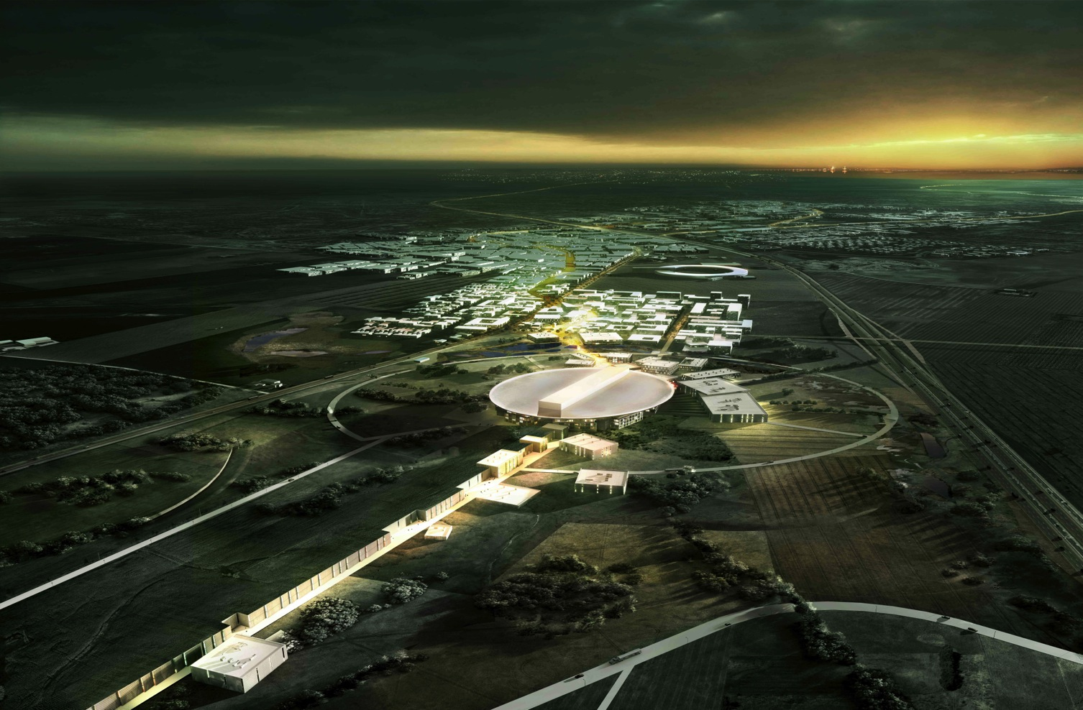
The view of the Southwest in 2025
    MAX IV – a national research facility, under construction, opens up in 2016
    Science City – a new part of town
    ESS – an international research facility
Copenhagen
(1 200 000)
Malmö
(309 000)
Lund
(113 500)
← MAX IV
← ESS

Slide 6
Applications of Cryogenics at ESS
Cooling for the cryomodules (2 K, 4.5 – 300 K and 40 K)
Cooling for the Target supercritical H₂ Moderator (16.5 K)
Liquid Helium and Liquid Nitrogen for the Neutron Instruments
Cooling for the cryomodule test stand (2 K, 4.5 – 300 K and 40 K)
This is accomplished via 3 separate cryoplants

Slide 7
Accelerator Cryogenics
Bulk of acceleration is carried out via 3 classes of SRF cavities: Spoke, Medium (β = 0.67 ) Beta Elliptical and High (β = 0.86) Beta Elliptical
No superconducting magnets in the accelerator. There are some in the instruments
Cavities operate at 2 K with a 40 – 50 K thermal shield
Inner power coupler cooling from 4.2 K to 300 K
Accelerator lattice permits an 14 additional cryomodules to compensate for lower than expected cryomodule gradients (Stage 2)

Slide 8



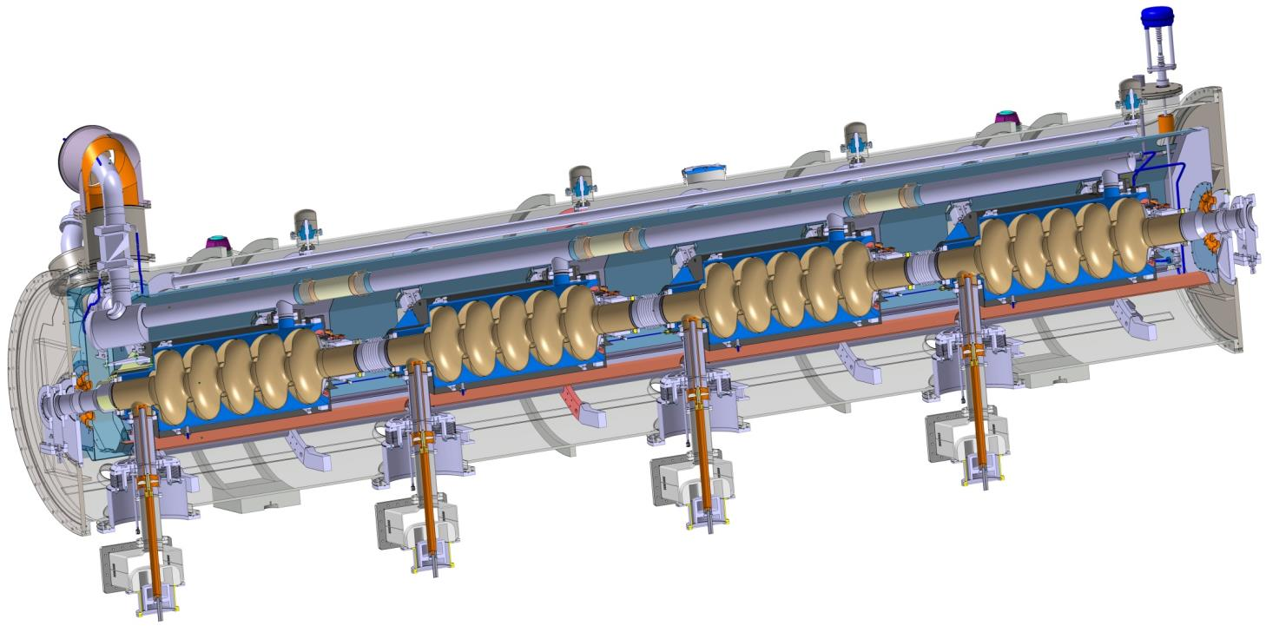
Elliptical Cavities & Cryomodule
Similar to CEBAF/SNS cryomodule concept with 4 cavities per cryomodule
Common design for medium (6 cells) and high beta (5 cells) cavities
Regulation He valve
Thermal shielding
Alignement fiducial
Vacuum valve
Jumper connection
Magnetic shielding
Spaceframe support
Heat exchanger
2 Phase He pipe
Proton Beam
Cavity with Helium tank
Intercavities belows
Power coupler
Cold to warm transition

Slide 9

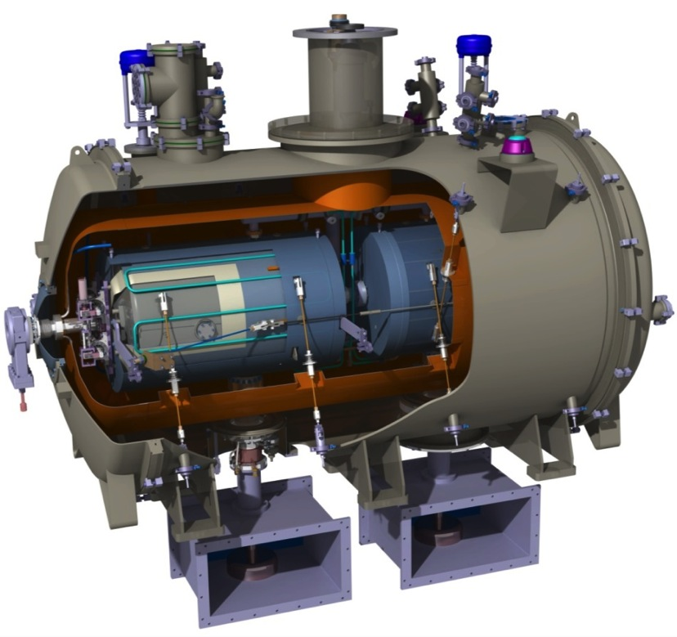
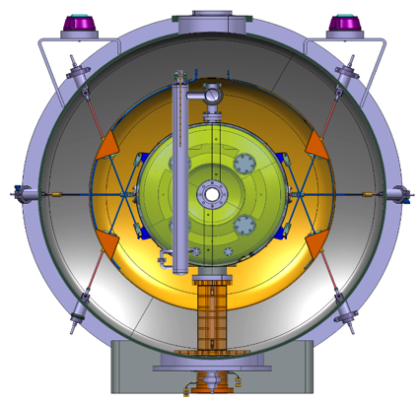
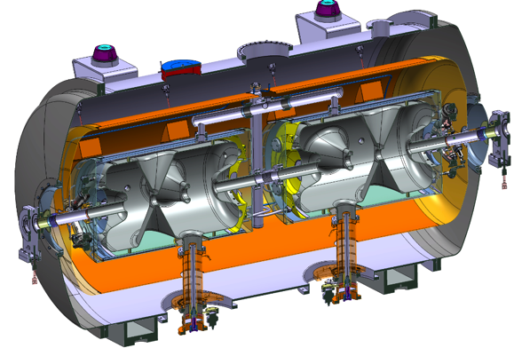
Spoke cavity string and cryomodule package
Diameter
1350 mm
2900 mm

Slide 10
ESS Accelerator Cryoplant (ACCP)
  Provides cryogenic cooling to Cryomodules
    13 Spoke and 30 Elliptical (Stage 1)
    Sized to allow an additional 14 Elliptical Cryomodules for design contingency (Stage 2)
  Allows for number of operating modes
  Connected to the cryomodules via a cryogenic distribution system
  High availability and turn down capability are important features
  Compressor heat is absorbed by Lund District Heating System (unique ESS feature)

Slide 11
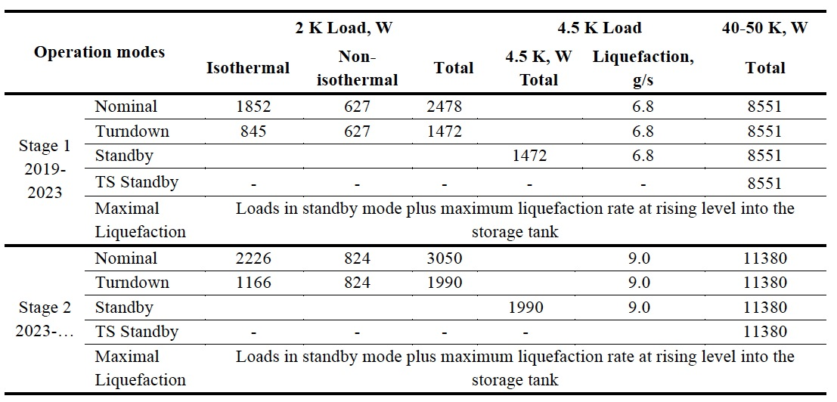
Accelerator Cryoplant (ACCP) Capacities

Slide 12
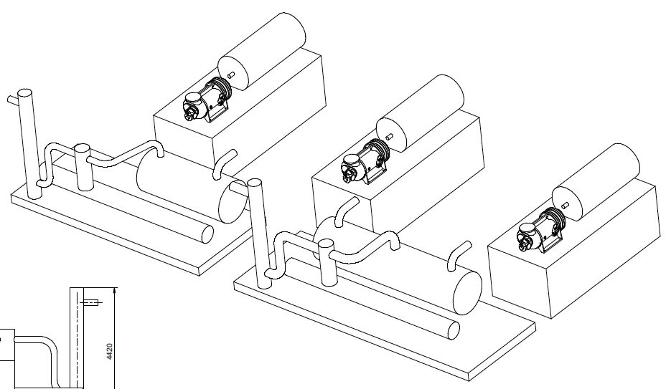
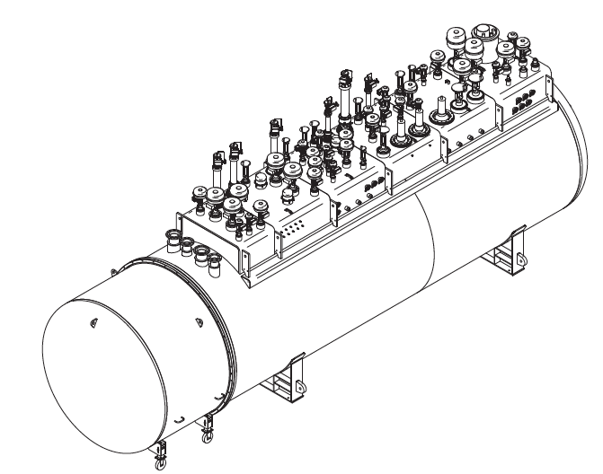
ACCP – Contract Award to Linde Kryotechnik AG in December 2014
Compressor System:
Three identical machines for SP→MP, LP→MP and MP→HP compression, hot standby compressor is under discussion
Kick Off Meeting was
held on May 8
System uses 3 cold compressors + 1 warm sub-atmospheric compressor for 2 K cooling
One Coldbox comprising 6 expansion turbines, 3 cold compressors, in-built acceptance test equipment
Notes:
Contract signature pending (expected March 2015), contract value < 20 million EUR (excluding installation, LHe Dewar, warm gas storage etc.)

Slide 13
Cryogenic Distribution System
Allows warm up and cool down of one or more cryomodules w/o affecting remaining cryomodules
Connection between distribution line & cryomodule is done via fixed connections
Separate isolation vacuums in the distribution lines and cryomodules
Operating modes defined
Conceptual design complete
Provided as an In Kind Contribution by IPN Orsay (France) and WrUT (Poland)
Cryogenic Distribution System must be complete and installed by December of 2017

Slide 14
Linac CDS – function and layouts
Cryogenic System of the Optimus Linac
Linac
Cryoplant
Cryogenic
Transfer
Line (75 m)
Cryogenic Distribution Line (310 m)
comprising 43 valve boxes
Auxiliary process lines
Endbox
Splitting
box
21 High Beta
Cryomodules
(174 m)
9 Medium Beta
Cryomodules
(75 m)
13 Spoke
Cryomodules
(54 m)
Superconducting section of the Optimus Linac (303 m)

Slide 15
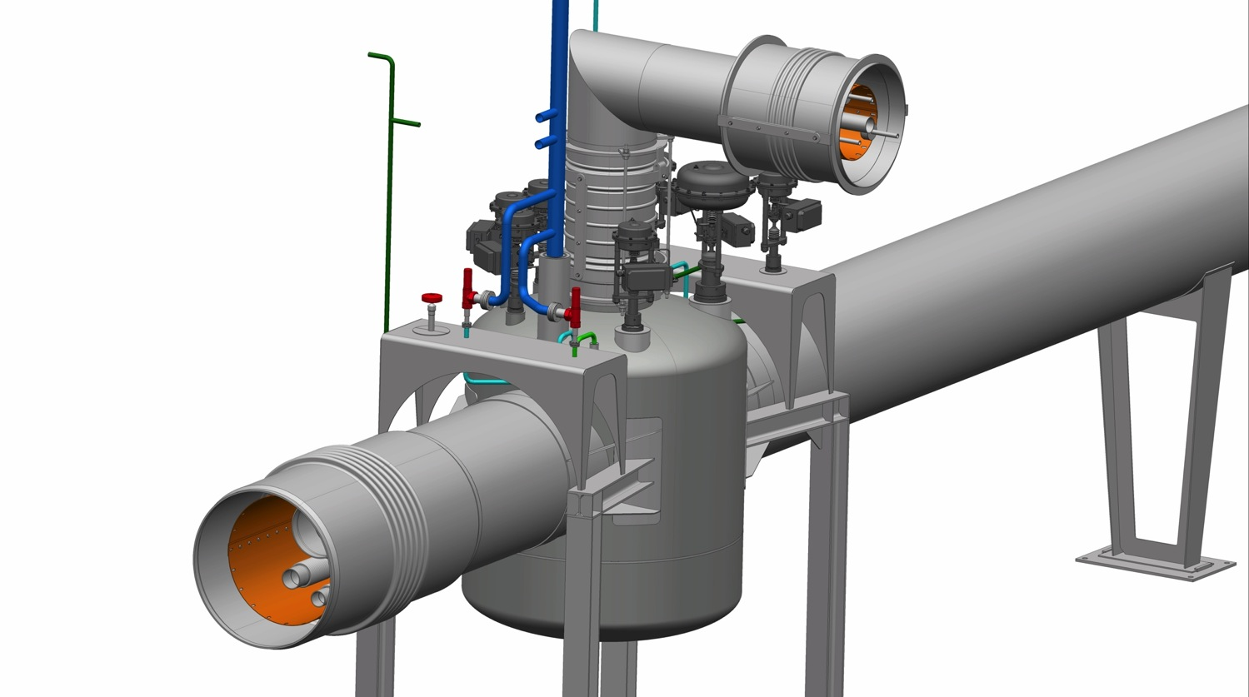
Valve box – vacuum jacket
Jumper connection vacuum jacket
with a lateral compensators
(vertical: DN350 horizontal: DN450 )
Interconnection
sleeve at the interface to the cryomodule
Cryoline interconnection
sleeve with axial compensator (DN600)
Cryoline vacuum jacket (DN550)
Valve box
vacuum jacket
Cryoline
support
Valve box
supports
Bottom plate
(demountable)

Slide 16
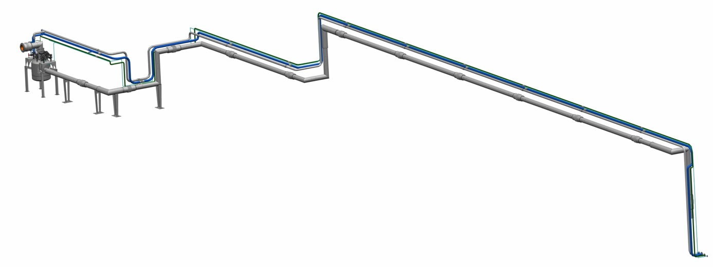
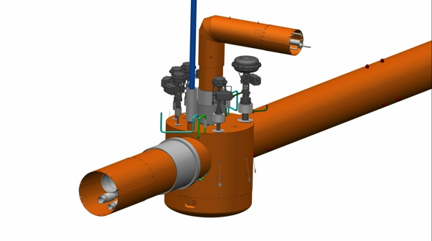
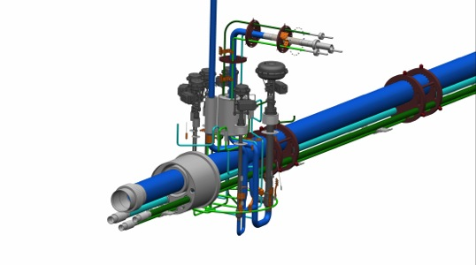

CDS – In kind Agreements with IPNO and WrUT
PDR was held with
WrUT on May 20
Notes:
Cryodistribution System is the farthest along. I
IPNO: CDS for spoke section
WrUT: CDS for elliptical section + CDS for Lund CM test stand

Slide 17
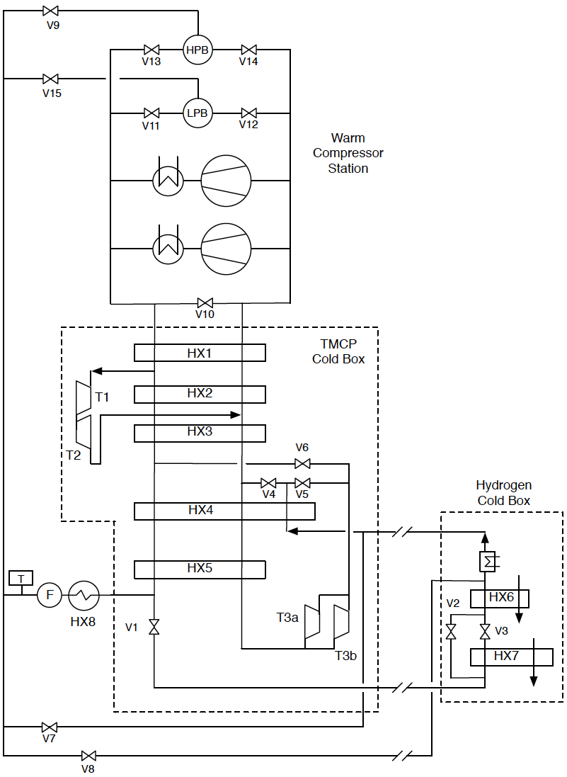
Target Moderator Cryoplant – Substantial Load Increase
Heat Load at 15 K increased from 20 kW to 35 kW due to moderator re-design (higher brightness, more neutrons)
Impact on space requirements, utilities, interference with other cryoplants and budget (minimal impact on schedule) – technical solutions are currently worked out
Tight collaboration with TU-Dresden, Hans Quack and FZ Jülich
Plant will likely be ordered in Q1 2016

Slide 18
Test & Instruments Cryoplant (TICP)
Provides cooling for Cryomodule Test Stand
During Science Operations, also provides LHe for sample environments and Science Instruments
TICP provides for CM testing: 76 W at 2 K, 422 W at 40 K and 0.2 g/s of liquid helium
Sub-atmospheric operation via warm vacuum pumps
During Science Operations, the TICP shall provide more than 7500 liters of LHe per month
A recovery system is being built to recover all He gas from instrument halls and return it for purification and liquefaction.
We expect to order this plant in Q4 2015

Slide 19
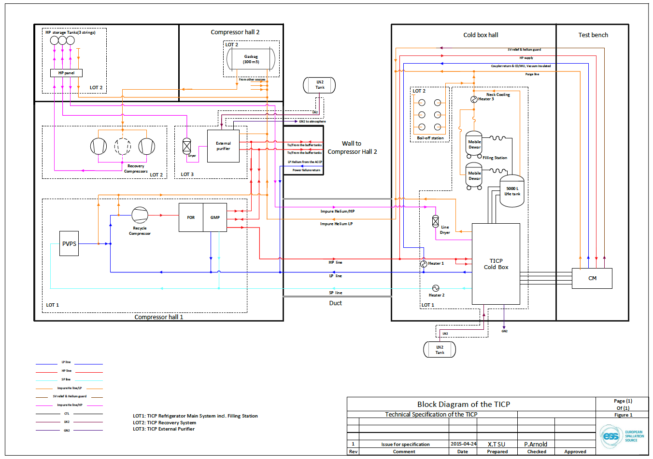
Test & Instruments Cryoplant (TICP)

Slide 20
Helium Recovery and Storage
The ESS goal is to recovery, purify and reuse as much He as possible
ACCP and TICP cryoplants will share a common gas system while TMCP has separate storage that can be cross connected
The system will include a separate cryogenic purifier
Systems will be provided by IKC or separate contracts
Expected He Storage Capacities:
  LHe
    20 m³ (Includes storage for second fill of linac)
    5 m³ (Backup for Instruments He)
  GHe (20 Bar)
    1000 m³ - sufficient to hold all the linac inventory
  GHe (200 Bar)
    12 m³ - Instrument He storage

Slide 21
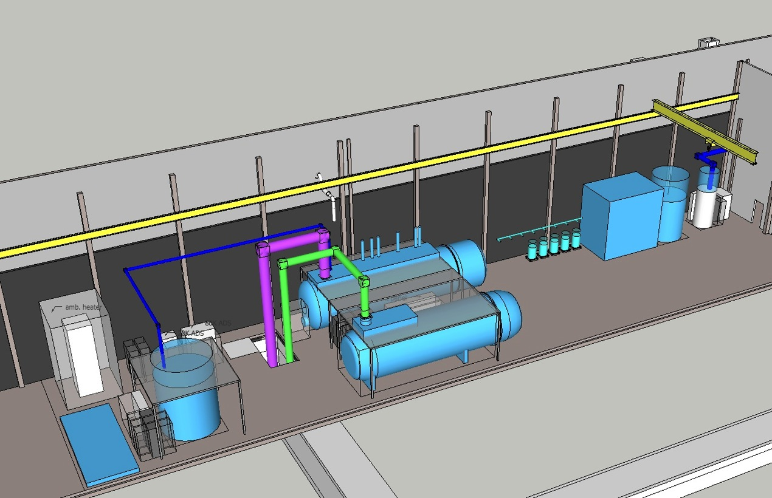
Plant arrangement in the Cold Box Building
TICP
5 m³ LHe Tank
ACCP
20 m³ LHe Tank
TMCP
21

Slide 22
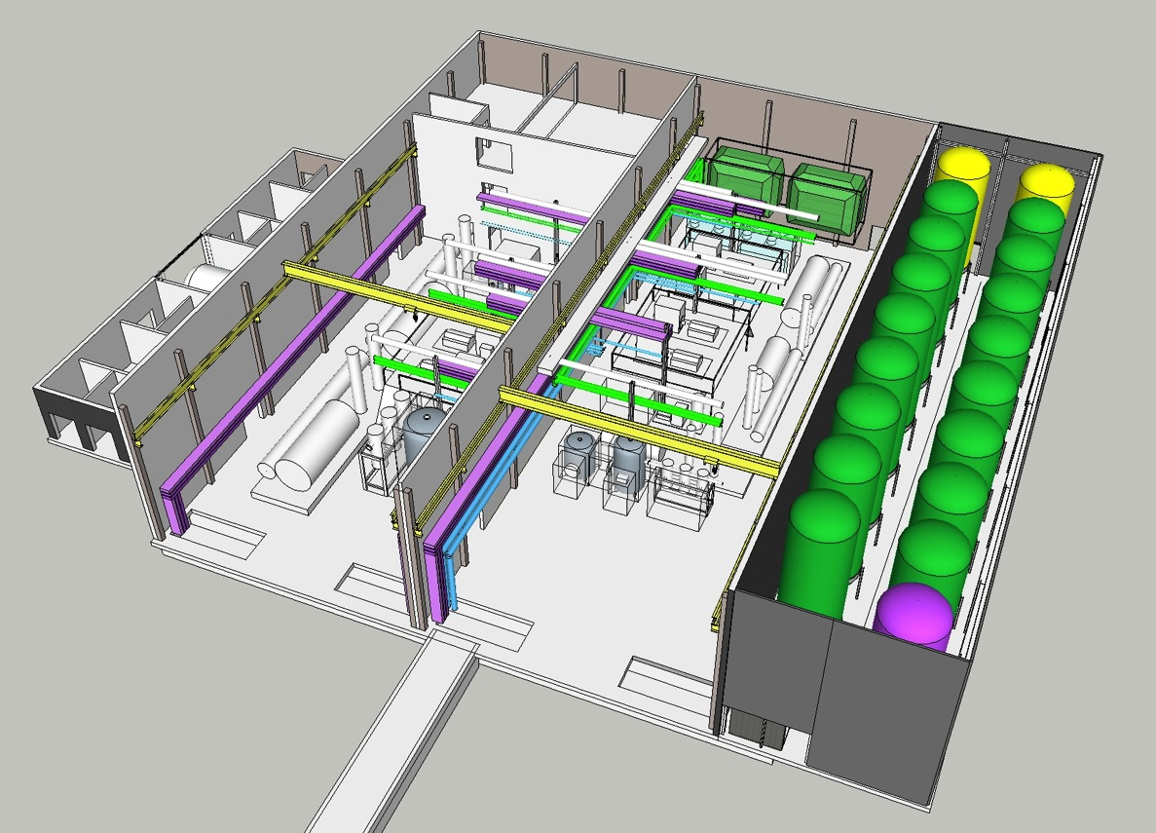
Plant arrangement in the Compressor Building
Compressor Hall for TICP and TMCP
Compressor Hall for ACCP

Slide 23
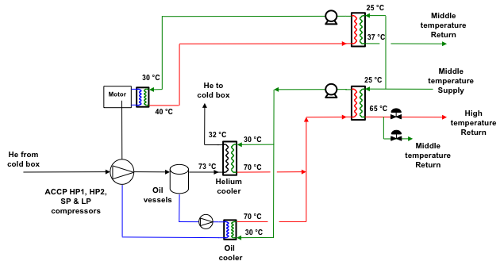
Energy Recovery from ACCP Compressors
During nominal operating mode
in Stage 2 – a total of 2.48 MW are deposited into District Heating from the ACCP

Slide 24
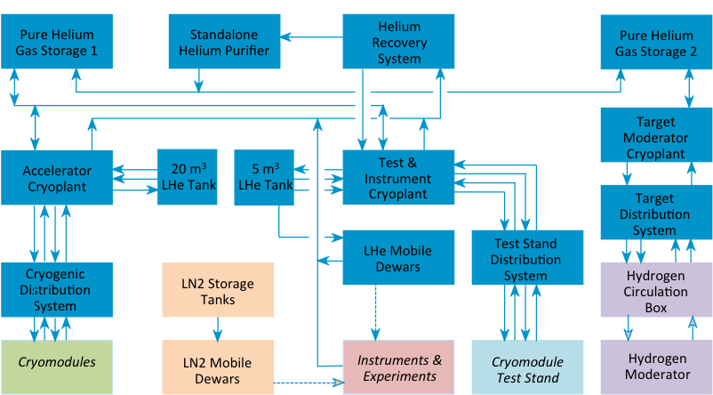
ESS Cryogenic System

Slide 25
WP11 Master Schedule

Slide 26
Summary
Cryogenics will play a major role in ESS and affects the accelerator, target and instruments projects
Work is well underway
  A very skilled team has been assembled
  Conceptual designs and technical specifications are complete or under preparation
  Required buildings and utilities have been defined and are under detailed design
  Accelerator Cryoplant order has been placed (Kick off meeting was held on May 8)
  PDR for the WrUT portion of the CDS was held on May 2015
  Additional cryoplant orders will be placed in late 2015 and early 2016

