Slide 1
G&C Large Helium refrigerators
Increasing Competitiveness and profit
Cold Box design & Acc.
6/3/2015l Pierre Roux Air Liquide Advanced Technologies
THIS DOCUMENT IS CONFIDENTIAL

Slide 2
WG #6
Group #6
Group #5
Cold box & periphericals
Manufacturing, Delivery & Site Integration
CB Design & CB equip,.
Instrument & control
Dewar, VTL, gas bag, …
- Manufacturing hours,
- Methods,
- Packing & transport,
- Installation,
- Start-up
Scope
Scope
WG
Leader
  V. Héloin
WG
Leader
  S. Crevatin

Slide 3
Functional analysis

Slide 4
WG #6 (1/2) cost breakdown
Costs are excluding contingencies, Insurance, overheads and commercial margin

Slide 5
WG #6 (2/2) cost breakdown
Costs are excluding contingencies, Insurance, overheads and commercial margin

Slide 6
Cold Box
Que pourrait-on faire de façon plus efficace / répétitive ?
Ou identifiez-vous des gains potentiels résultants de la standardisation?

Slide 7
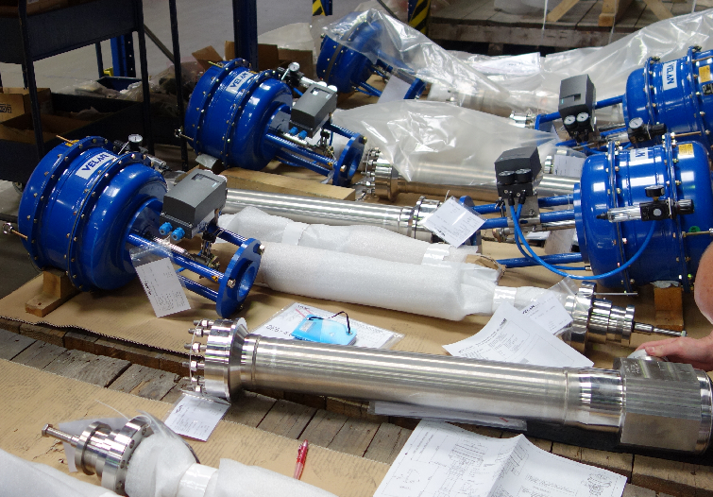
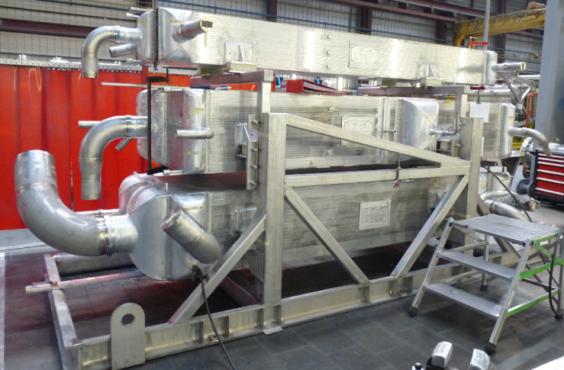
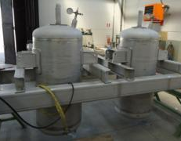
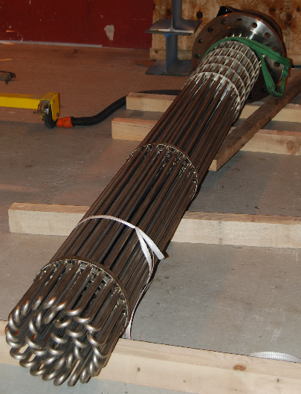
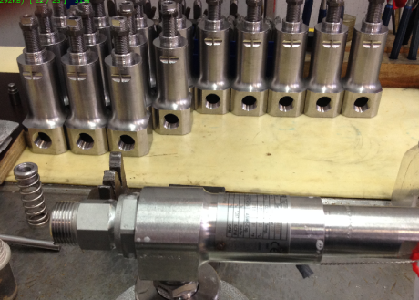
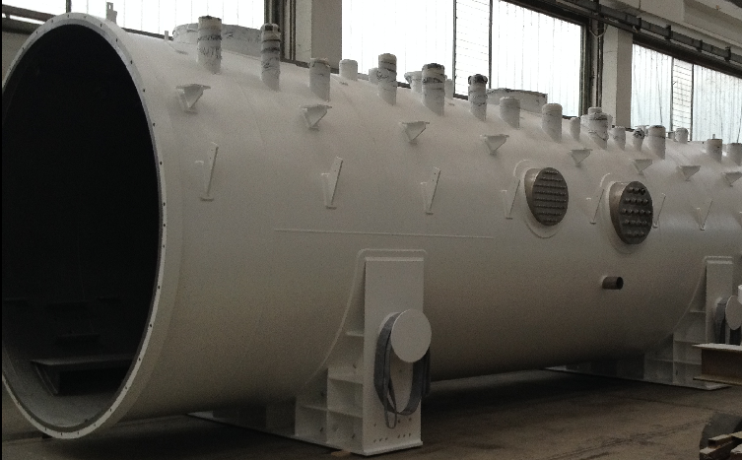
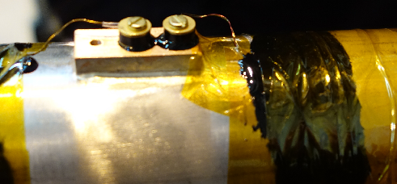
Equipment: : Purchase for assembling
Cryovalves
Heat Echangers
Adsorbers
PSV
Electrical Heaters
Temperature
Vacuum Vessel

Slide 8
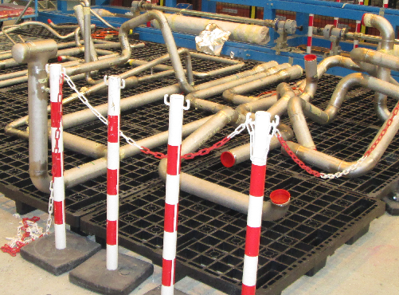
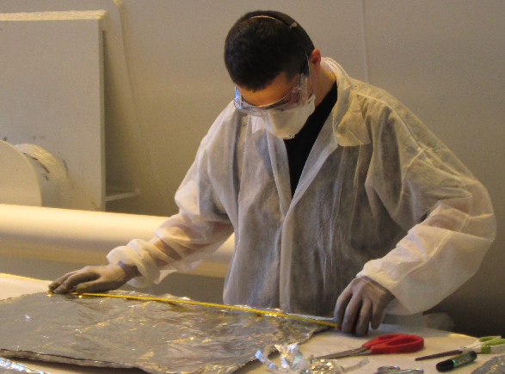
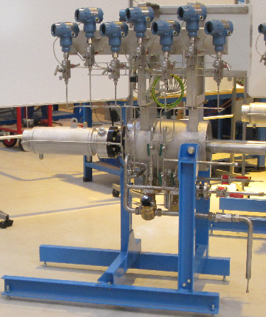
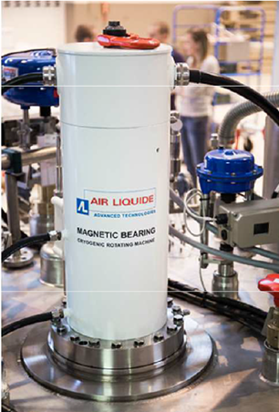
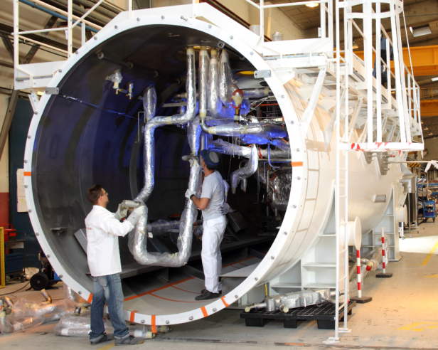
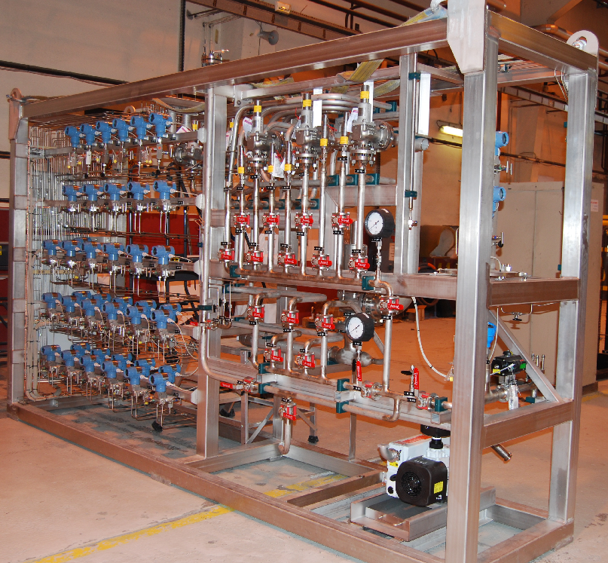
Equipment: Manufacturing at ALAT
Piping
Insulation
Cryogenic Rotating Machines
Cold Box Integration
Warm Panel Integration
Cold Box Integration

Slide 9
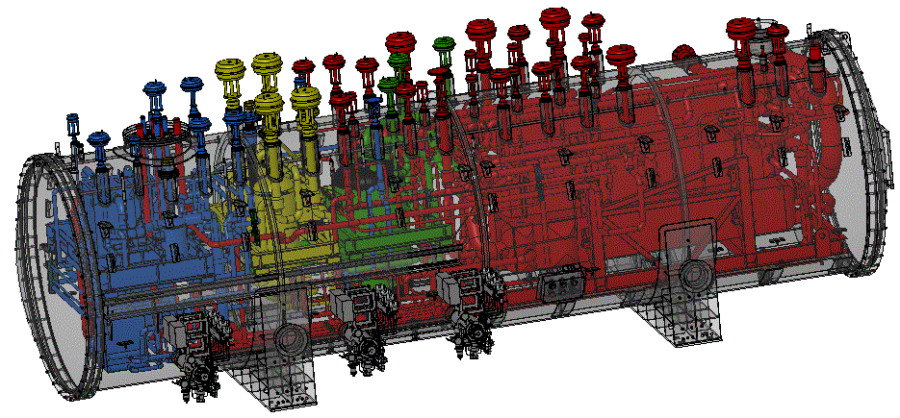
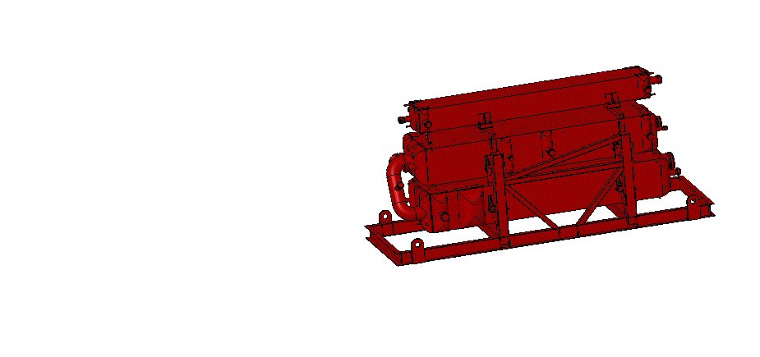
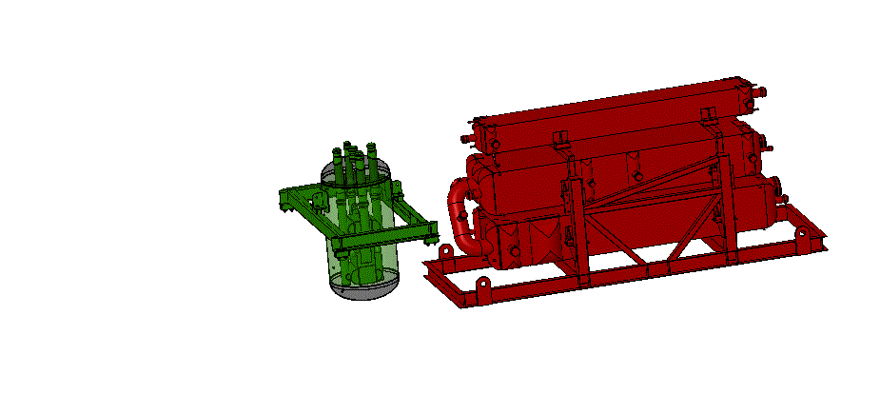
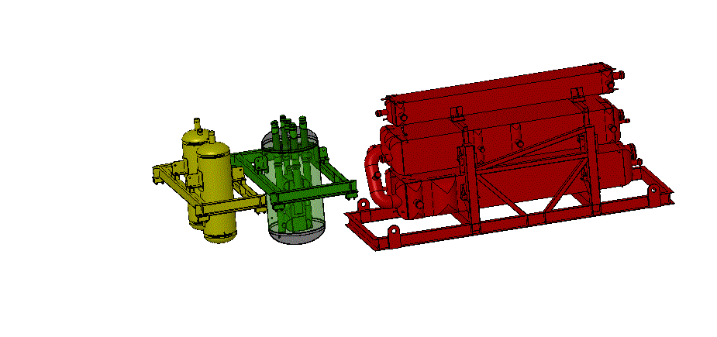
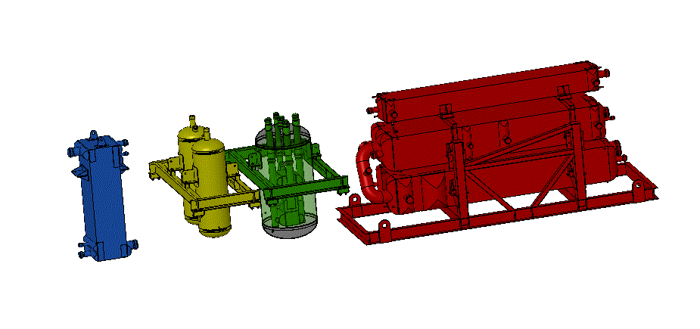

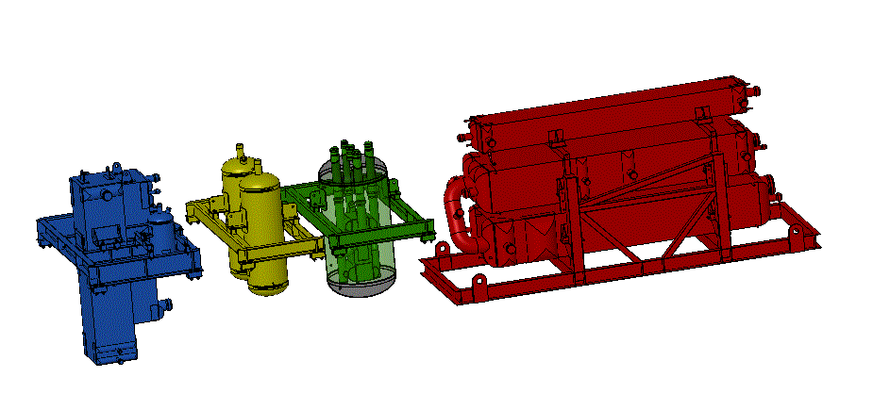
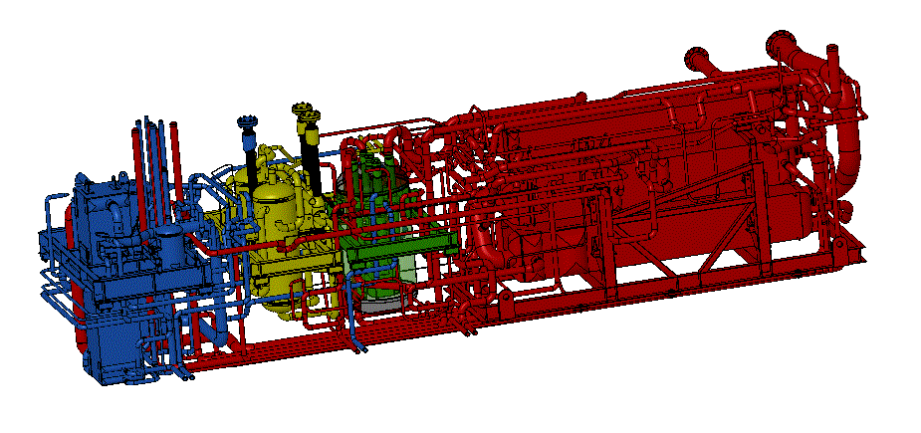
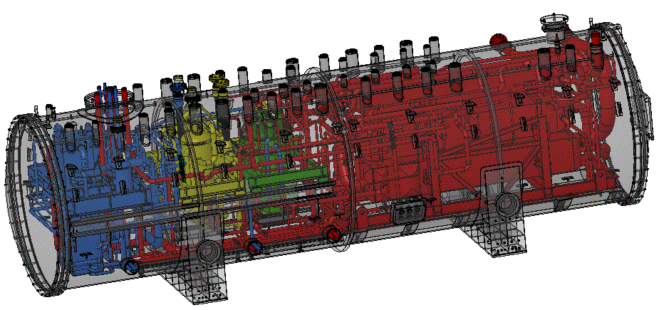
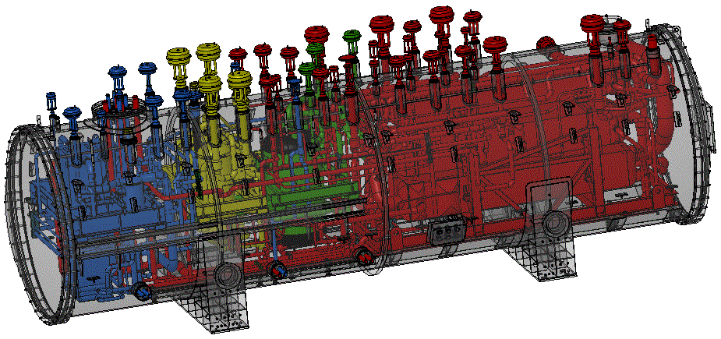
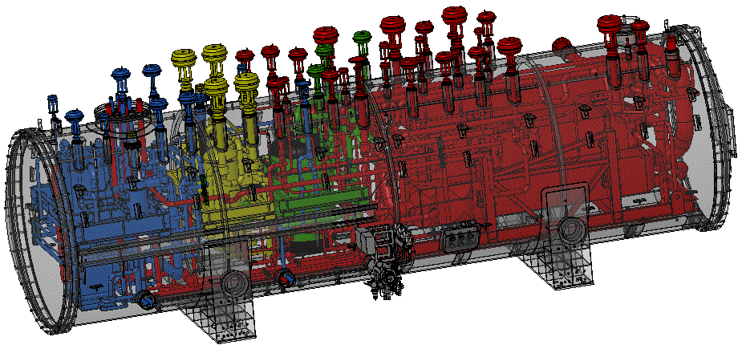

RCB Example – JT60SA
LN2 Phase Separator
(Could be replaced by 2 Turbines)
Main HX Battery
Cold HX + Ads.20K
Ads.80K
T1
T2
T3
Overall dimensions (Ø~3m, L~12m)

Slide 10
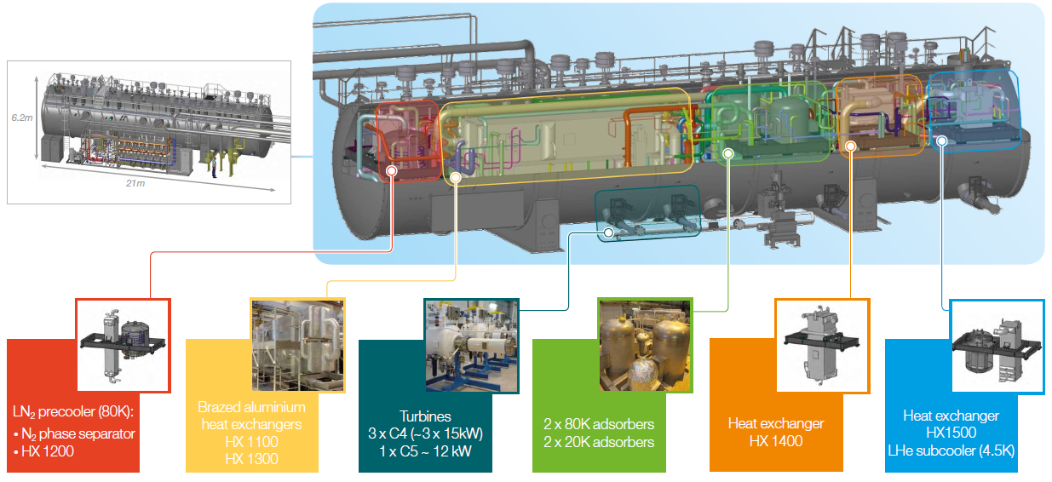
RCB Example – ITER

Slide 11
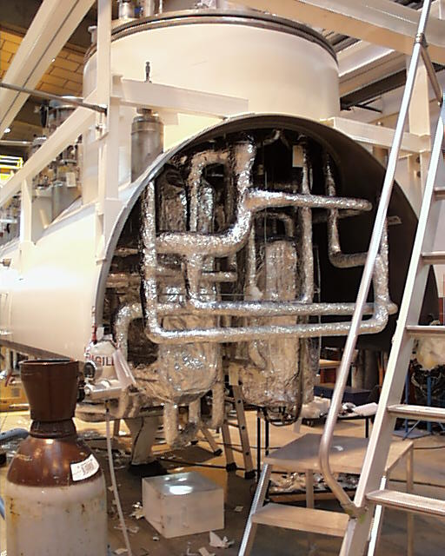
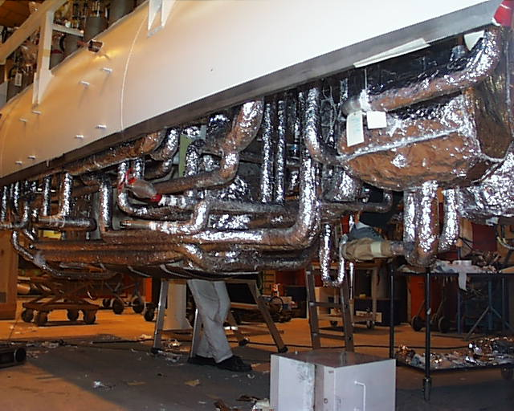
RCB Example – CMS – AL ITALIA → SIMIND

Slide 12
Possible Process to be challenged.

