Slide 1
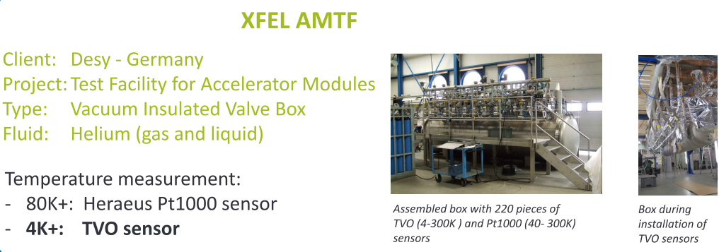

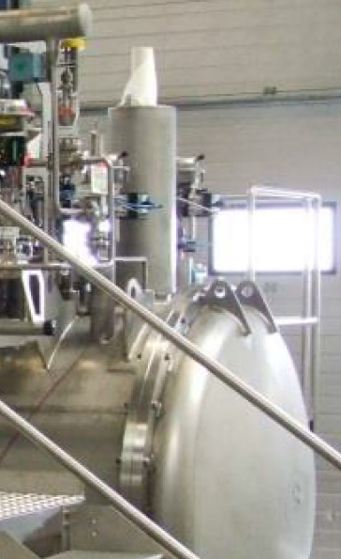
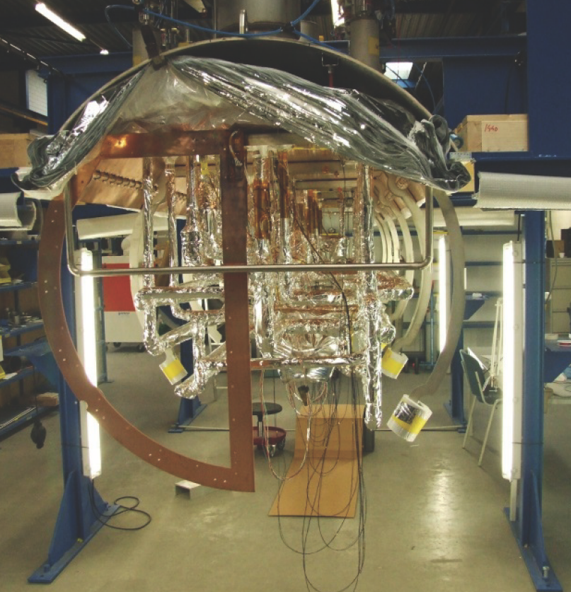
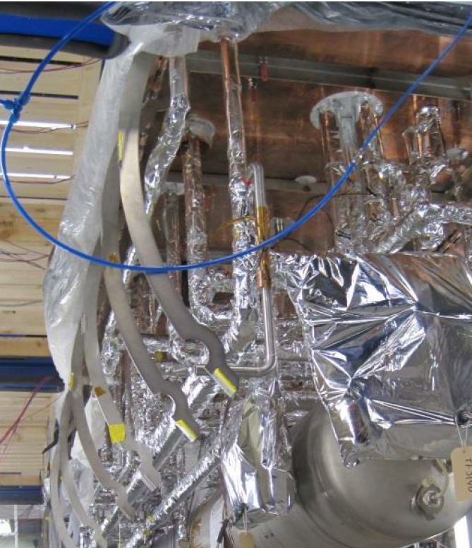

Slide 2

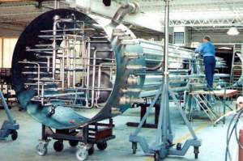
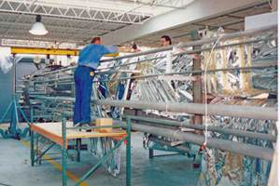
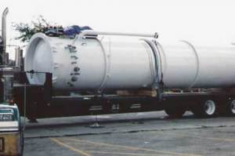
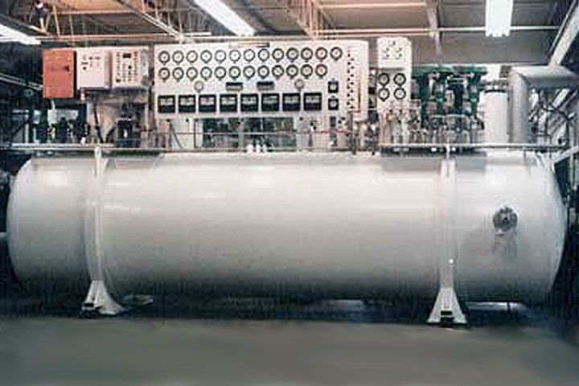

Slide 3
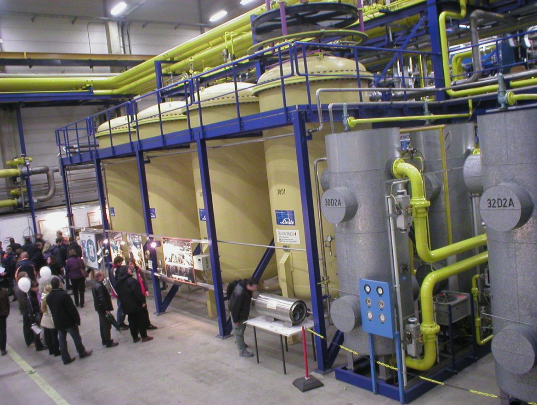
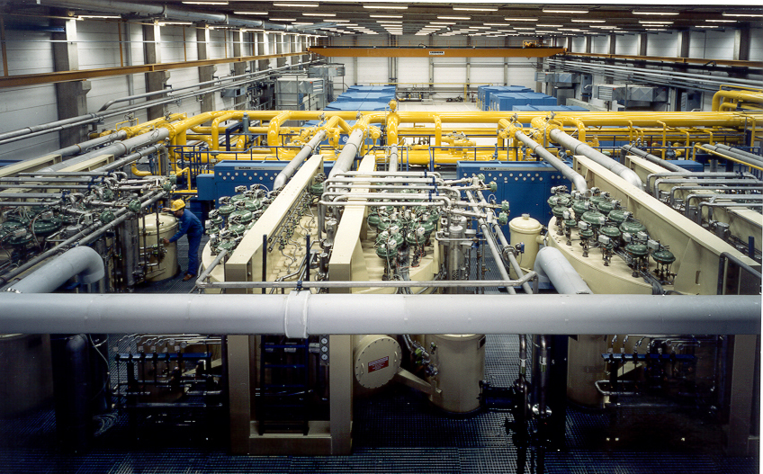

Slide 4
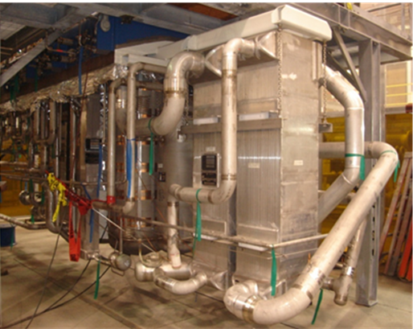
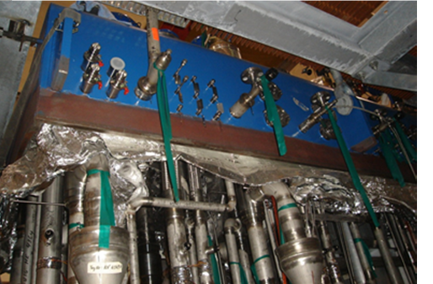
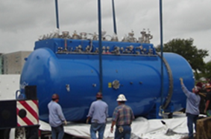

Slide 5
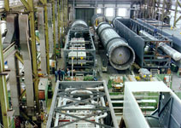
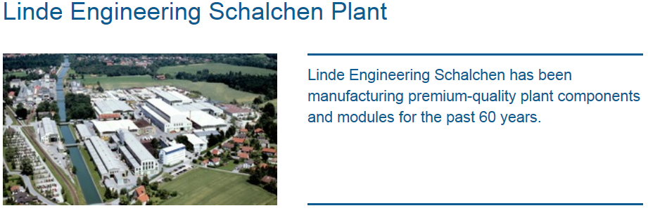
Packaged units are fabricated up to
4.2 m by 6.0 m with length up to 42 m.
Cold boxes with dimensions exceeding transport limits are assembled and tested at Linde workshops located near harbours or on site.
The spool-fabrication is performed in the workshop Schalchen with optimized fabrication lengths for an efficient installation into the cold boxes.
The plant is located at Tacherting, about 100 km east of Munich, Germany, and covers an area of approximately 200,000 m².

Slide 6
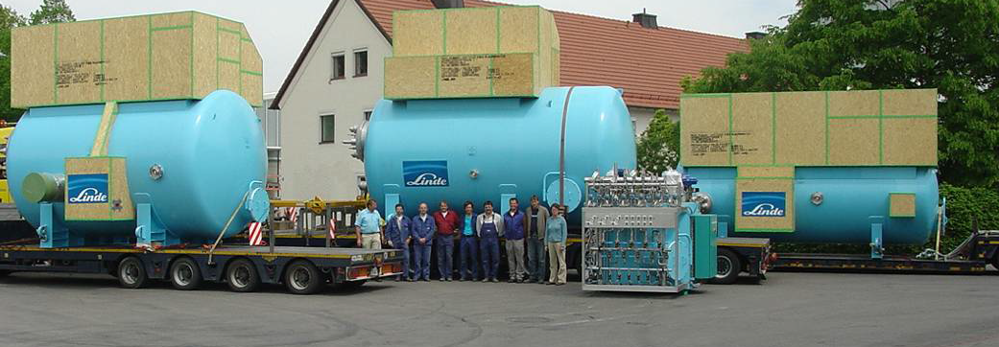
W7X 4 plants delivered by Linde (made in Germany)
http://www.linde-kryotechnik.ch/1259/1260/1275/1645/1658/1643/1428.asp
In May 2007 the four required cold boxes for the helium refrigerator with a total weight of 77 tons have been delivered to the MPI in Greifswald
The journey started in Schalchen (Bavaria, Germany) and went via Nuremberg, Frankfurt a.M., Cologne, Hannover and Berlin as well as through Polish territory.

Slide 7
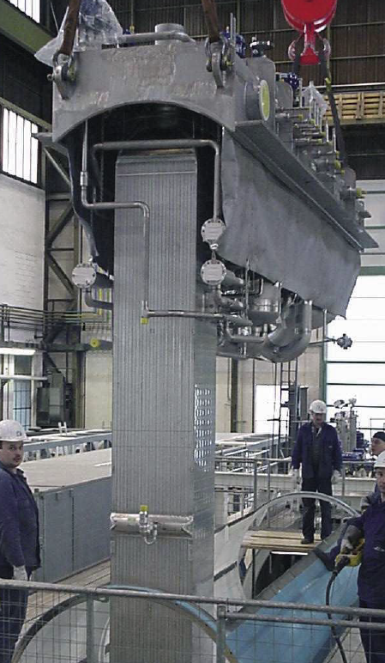
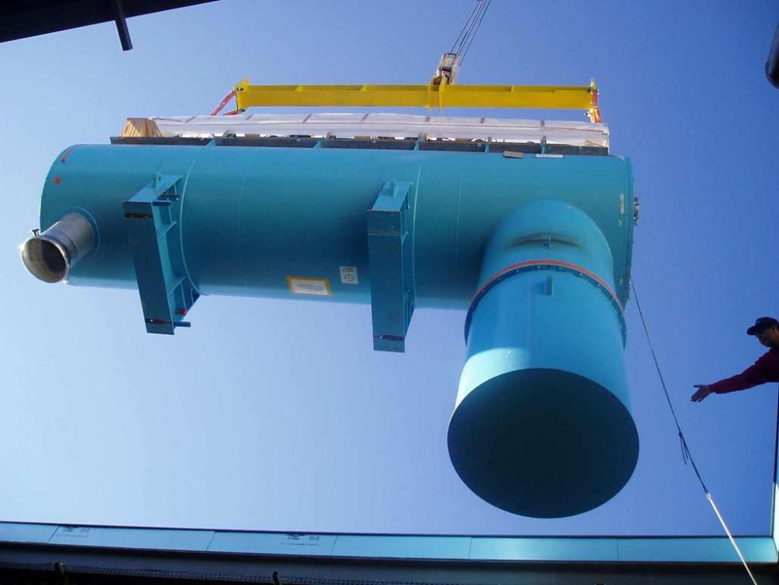
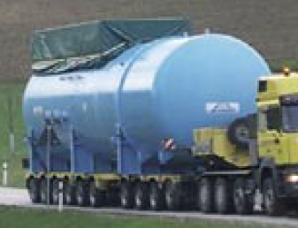

Slide 8
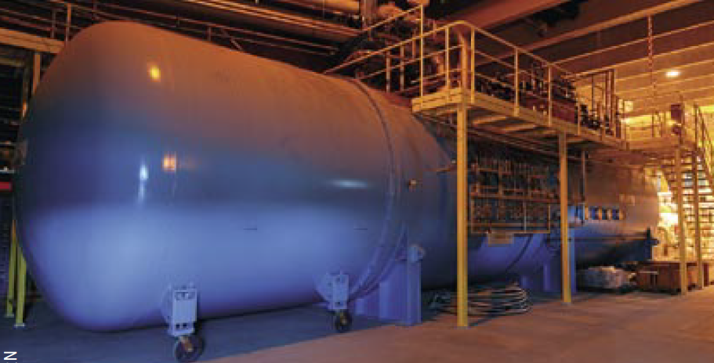

Slide 9
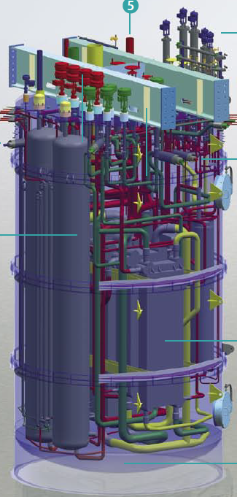


Slide 10
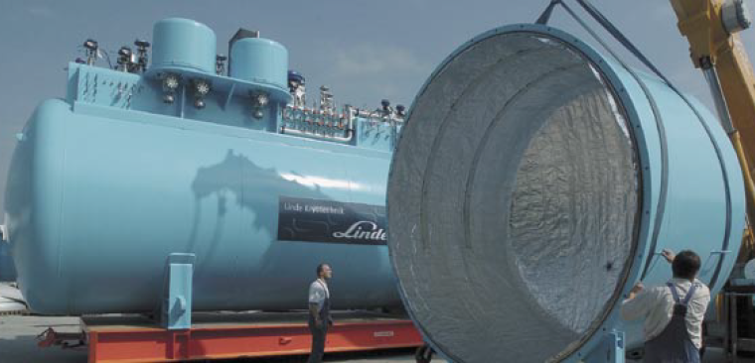
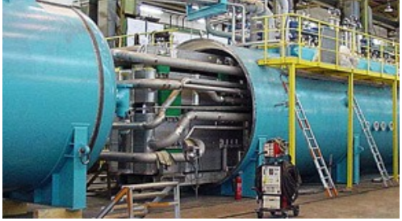

Slide 11
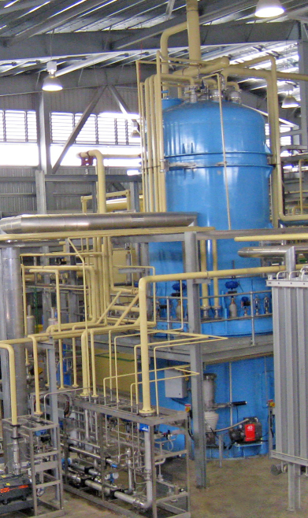
DARWIN

Slide 12
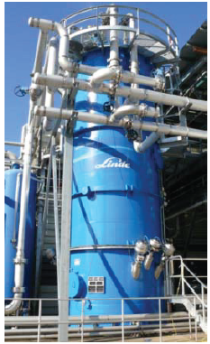
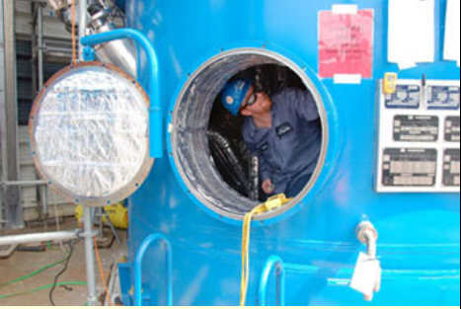
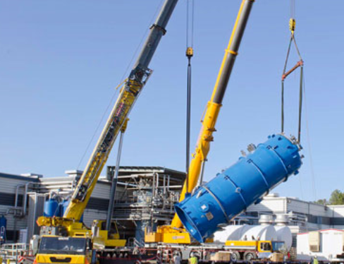
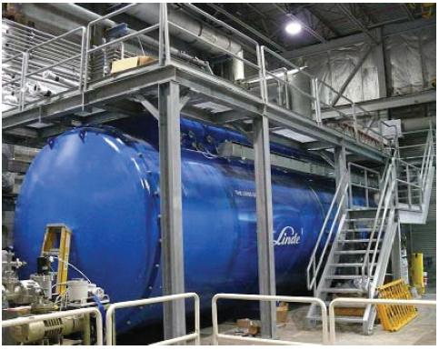
JLAB
Installed upper (outside) 300-60 K cold box
Installed lower (indoor) 60-4.5 K cold box

Slide 13
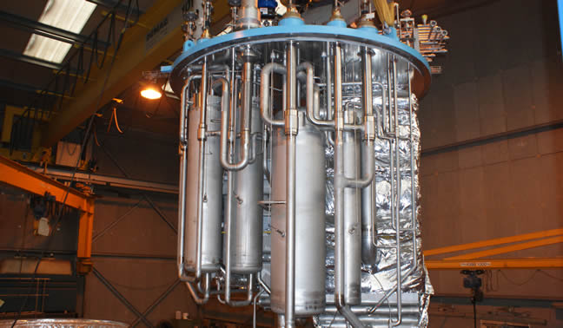
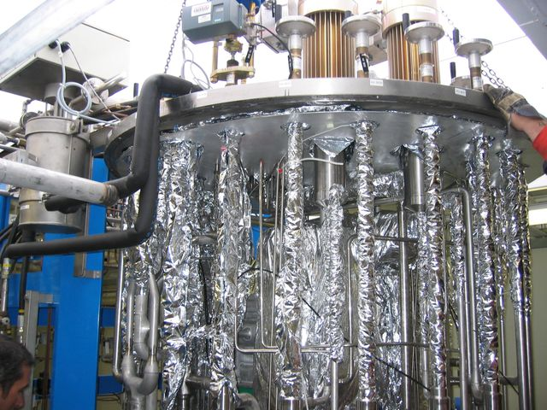
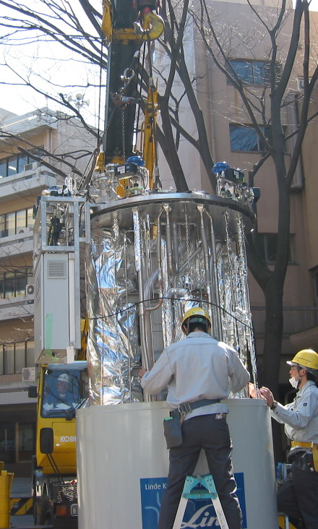
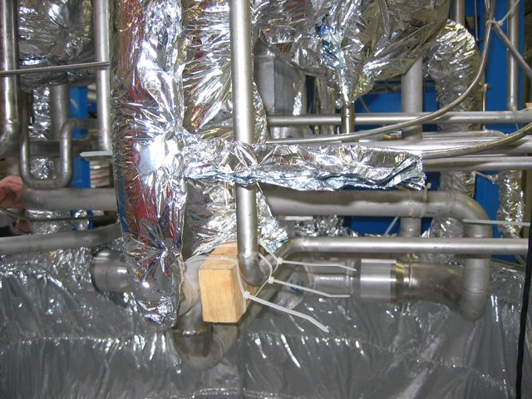
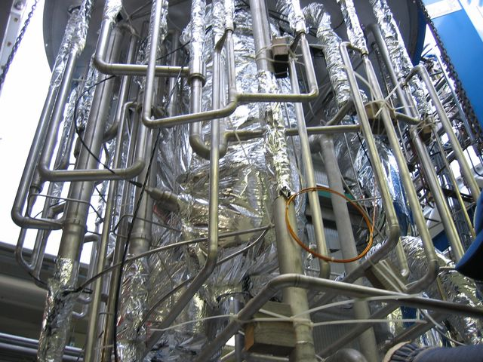

Slide 14
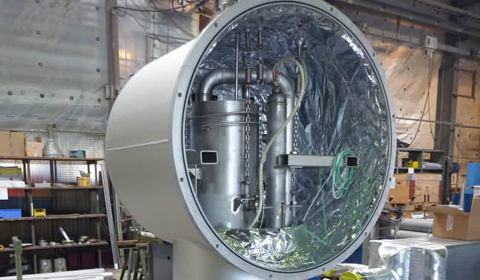
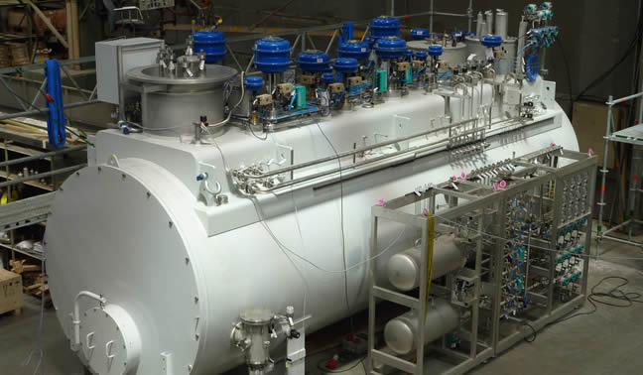
FLAT HEAD

Slide 15
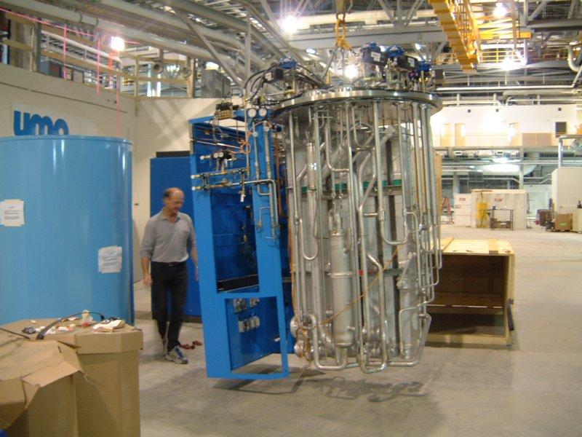
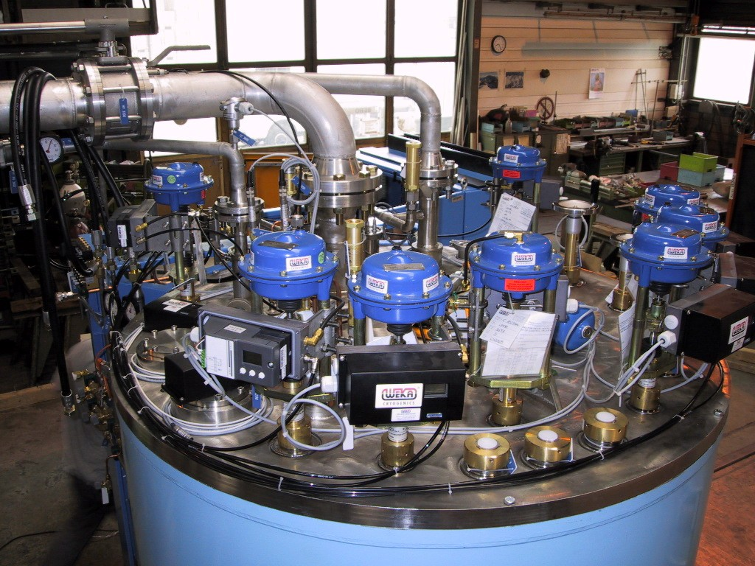
http://www.lightsource.ca

Slide 16
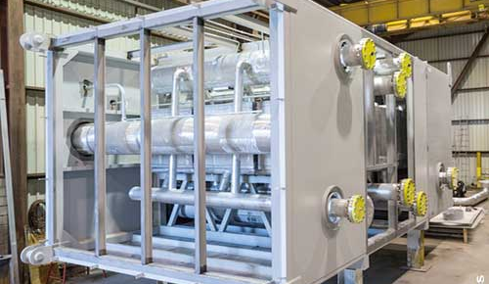
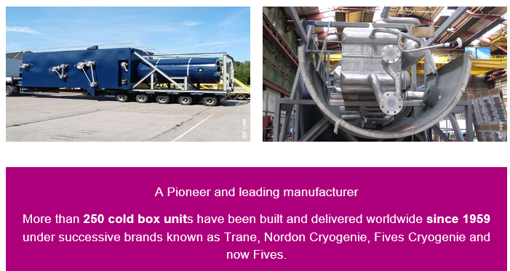
cryogenics-energy.fivesgroup.com

Slide 17
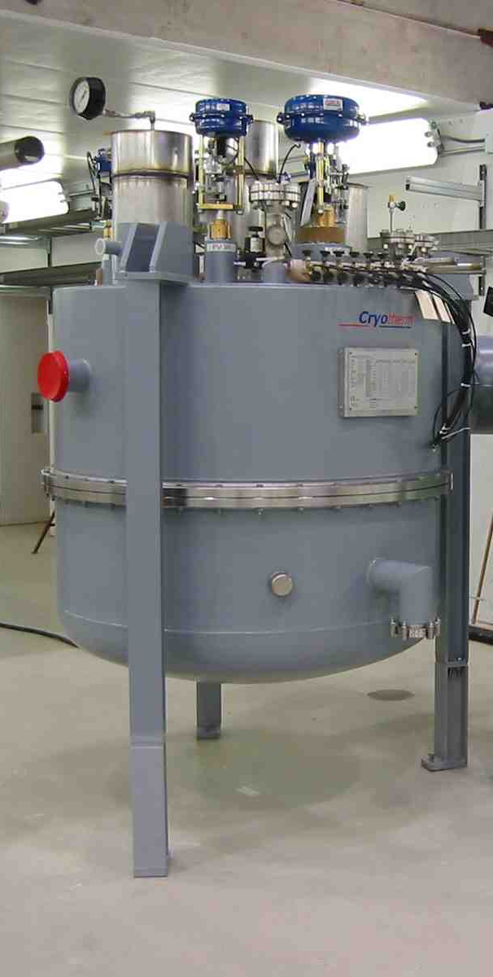
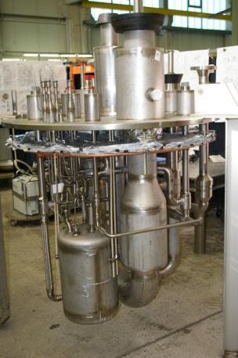
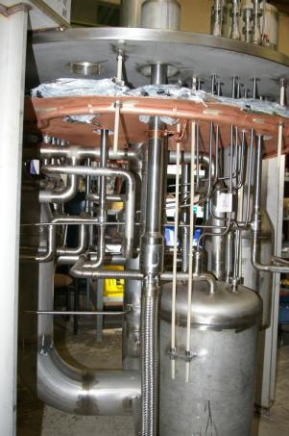
Fermilab
Feedbox contains J-T heat exchanger, dewar/subcooler/phase separator, all the valves and instrumentation to distribute cryogens to all of the CM circuits

Slide 18
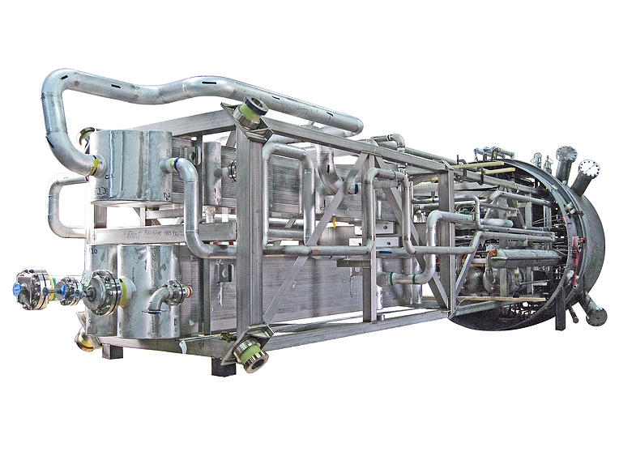
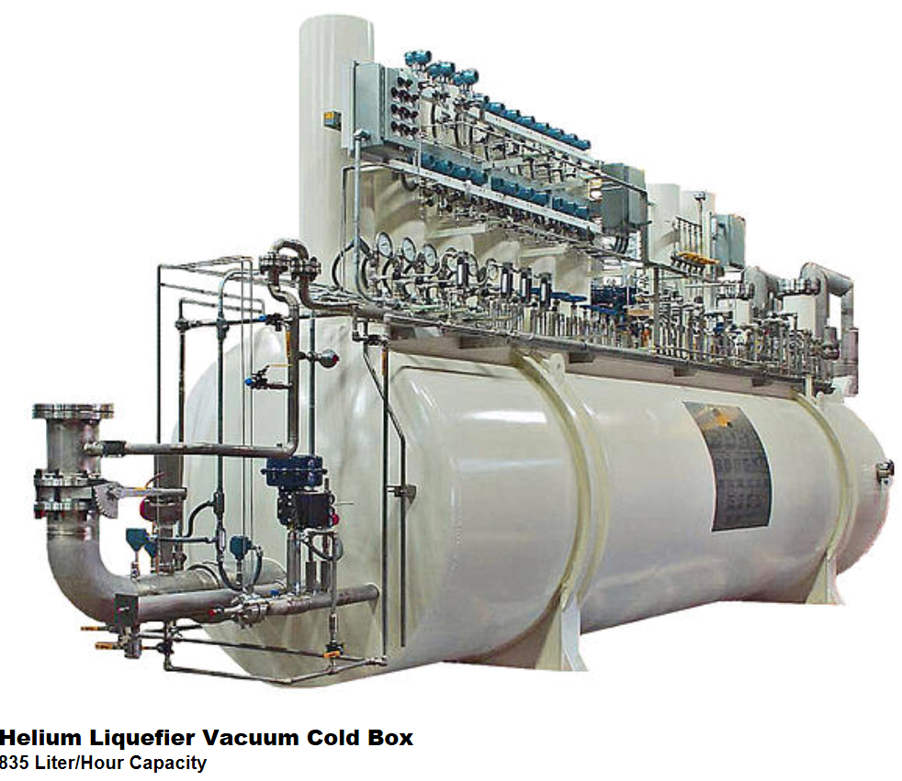
www.cryotechnologies.com

Slide 19
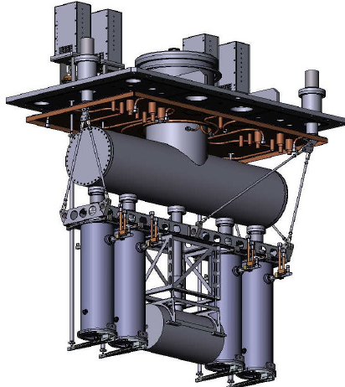
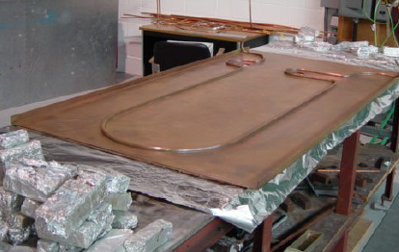
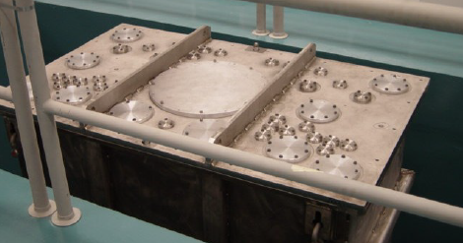
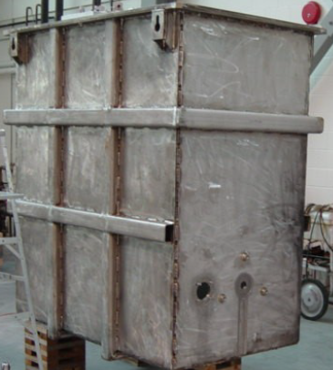
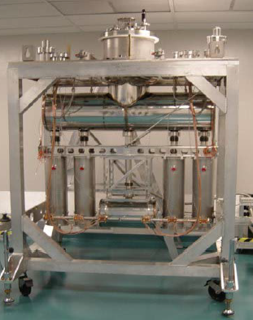
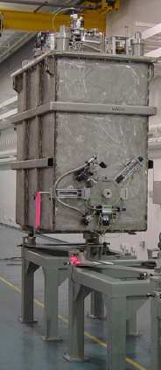
ISAC-II SC-Linac Cryomodule at TRIUMF
Nitrogen Heat Shield
10mm ID copper tube soldered to copper sheet arranged in a box-like structure
Vacuum “Tank” 1.9cm thick stainless steel (316L) with external reinforcing ribs L=176cm, W=99cm, H=196cm

