Slide 1
G&C Large Helium refrigerators
Increasing Competitiveness and profit
Compressors
6/3/2015l Pierre Roux Air Liquide Advanced Technologies
THIS DOCUMENT IS CONFIDENTIAL

Slide 2
Overall functional analysis

Slide 3
Functional analysis

Slide 4
Typical Needs

Slide 5
Some available screws / manufacturer

Slide 6
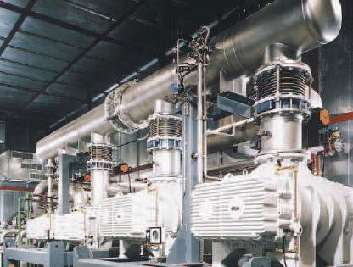
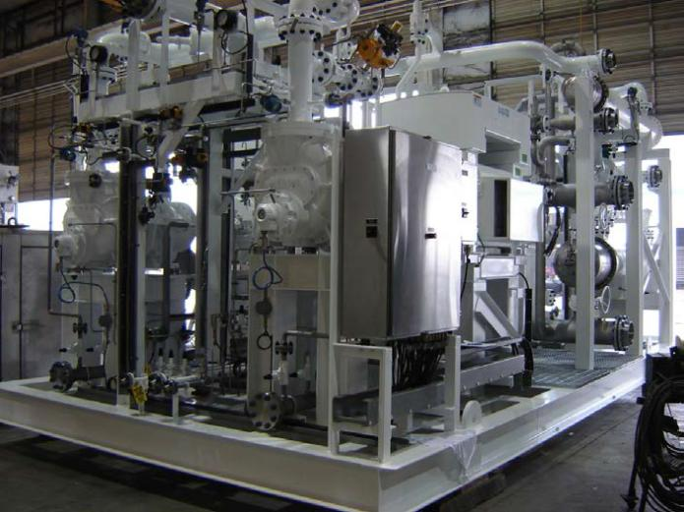
Screw Compressor skids
Sub atm pump
VLP-> LP
Helium Cycle Compressors
LP->MP->HP
(*) VLP ->LP or VLP->MP

Slide 7
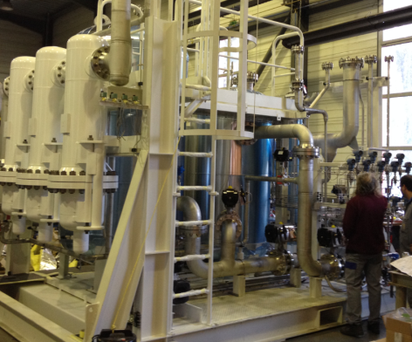
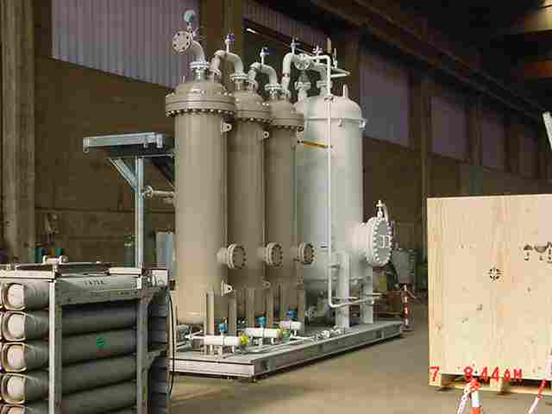
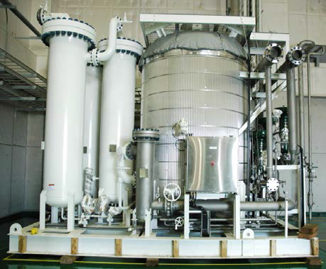
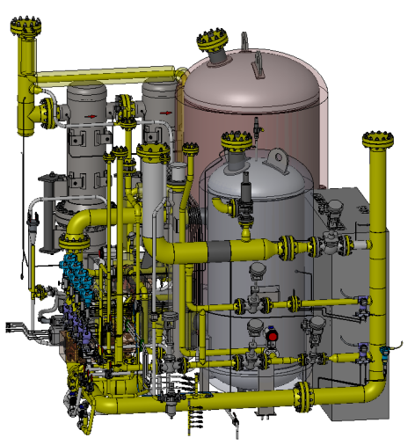
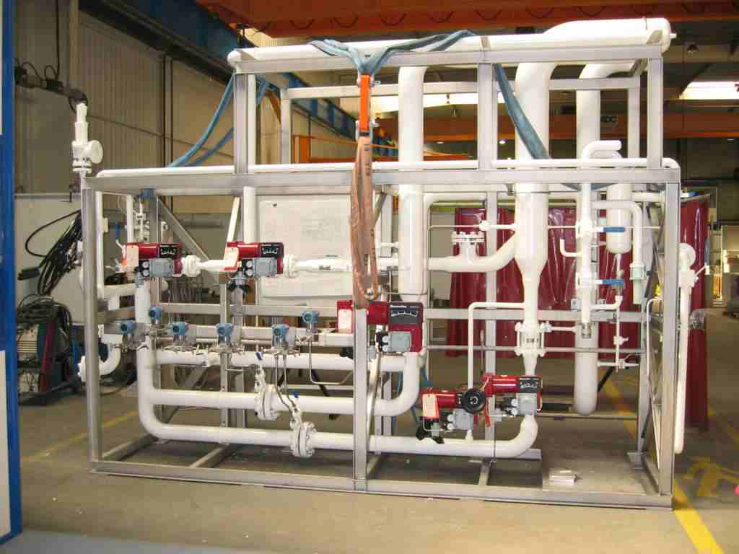
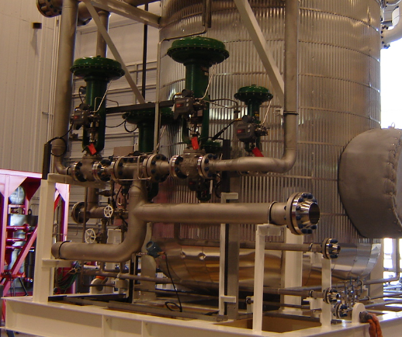
Oil Removal System (incl pressure control valves)
ORS JT60SA
QATAR I
KSTAR
Dryer
Compressors Pressure control

Slide 8
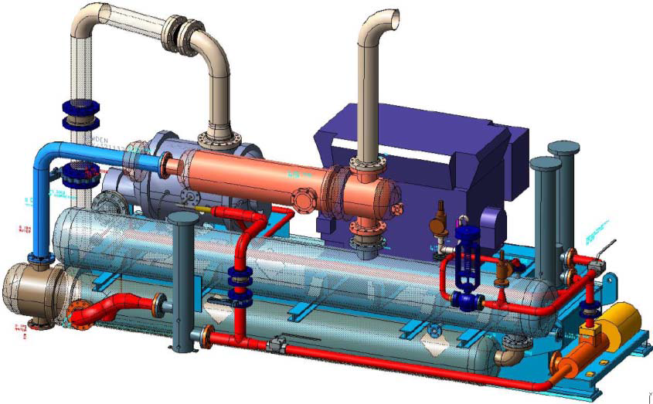
HOWDEN – NASA-JSC - 20K Helium Refrigerator
NASA-JSC, selected Howden WRVi 321/132
Used compressor for NASA-JSC as a prototype for 12GeV compressors

Slide 9
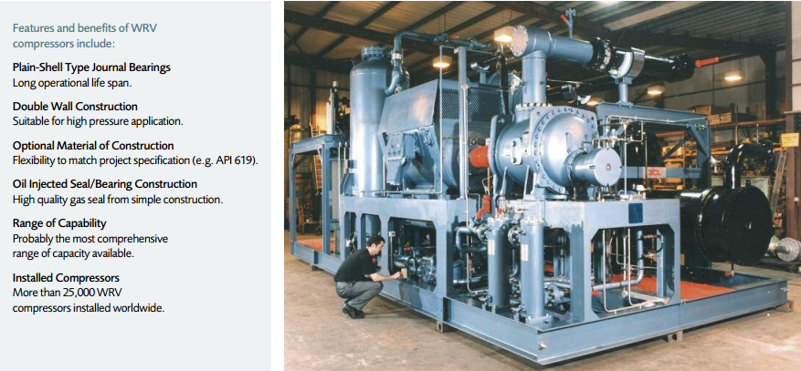
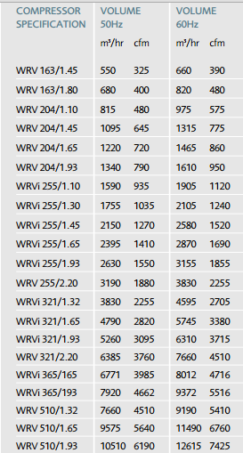
HOWDEN

Slide 10
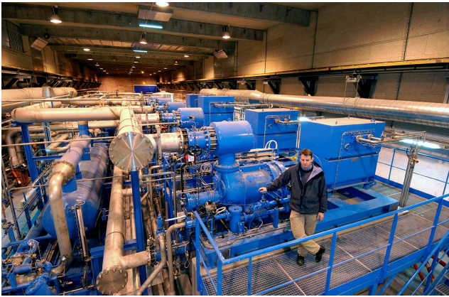
AERZEN

Slide 11
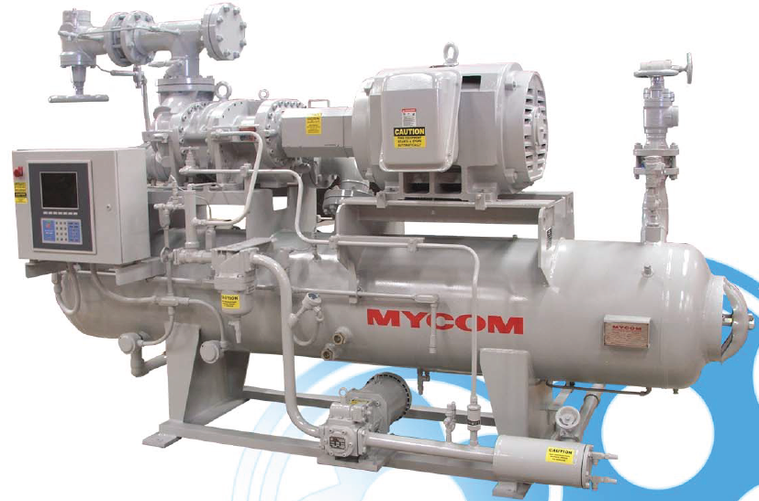
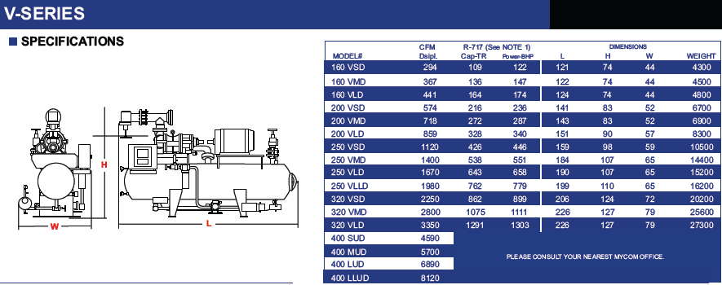
STANDARD PACKAGE

Slide 12
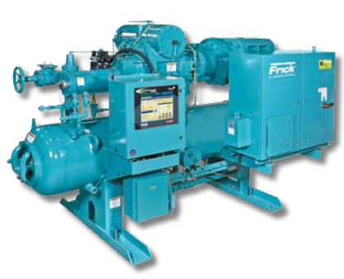
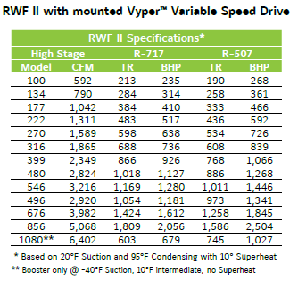
STANDARD PACKAGE

