Slide 1
G&C Large Helium refrigerators
Increasing Competitiveness and profit
Product Strategy & Management
6/3/2015l Pierre Roux Air Liquide Advanced Technologies
THIS DOCUMENT IS CONFIDENTIAL

Slide 2
Overview of next projects to win

Slide 3
Overall functional analysis

Slide 4
Overall functional analysis

Slide 5
Functional analysis

Slide 6
Functional analysis
Qu’est-ce qui serait selon vous standardisable ?
Que pourrait-on faire de façon plus efficace répétitive ?

Slide 7
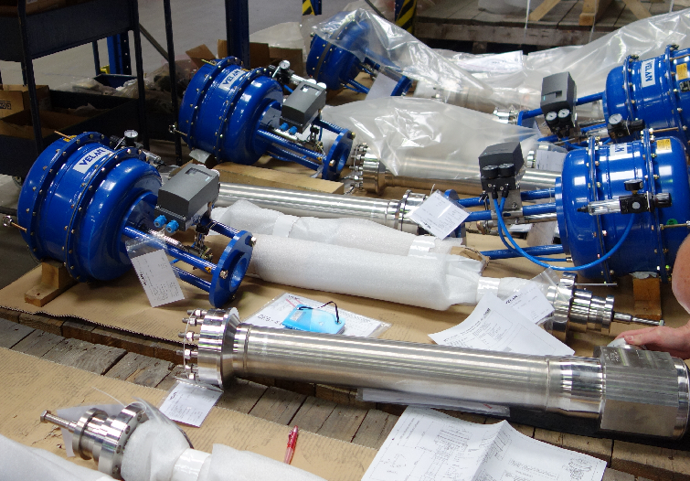
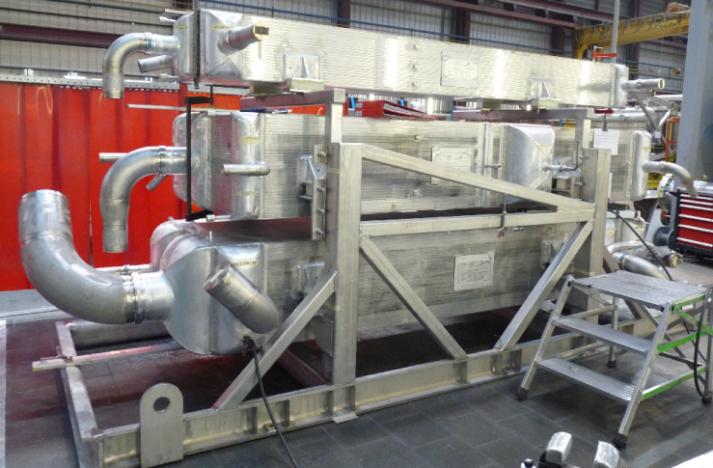
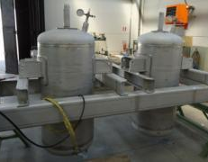
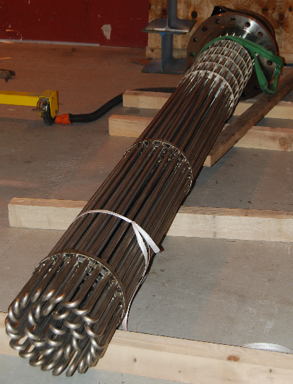
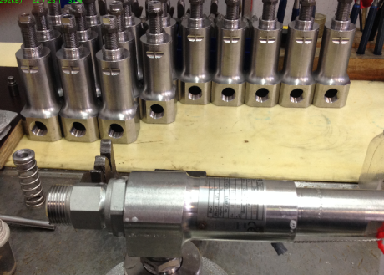
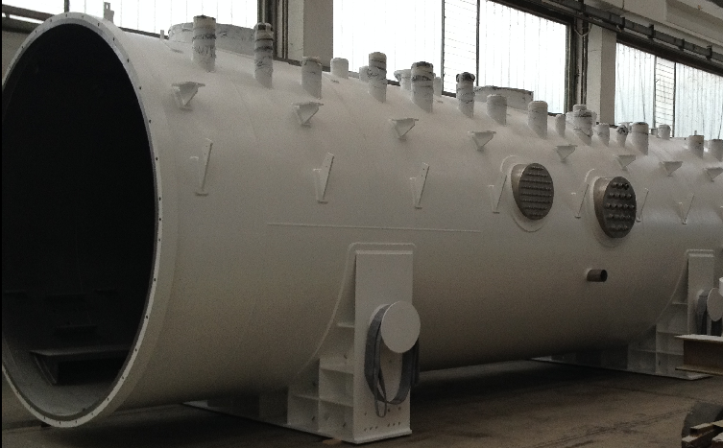
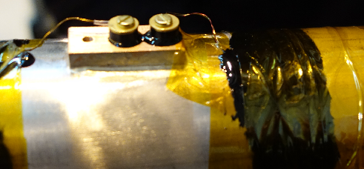
Equipment: : Purchase for assembling
Cryovalves
Heat Echangers
Adsorbers
PSV
Electrical Heaters
Temperature
Vacuum Vessel

Slide 8
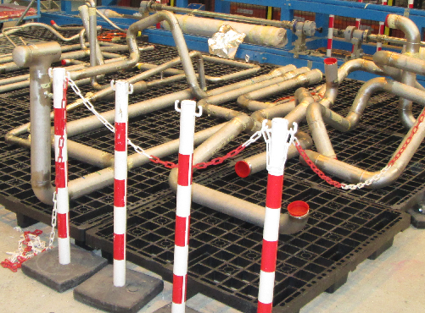
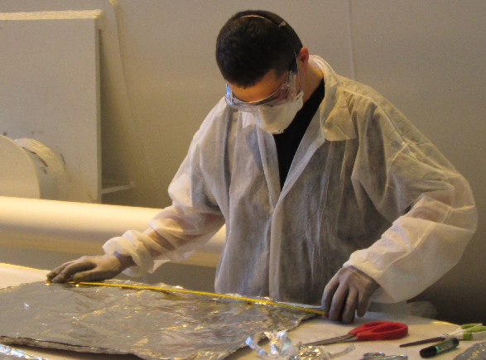
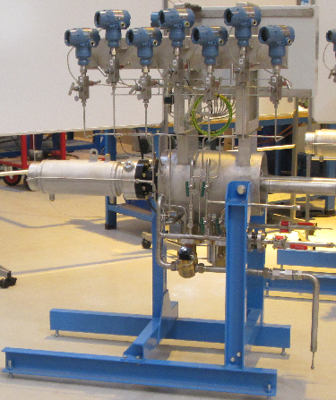
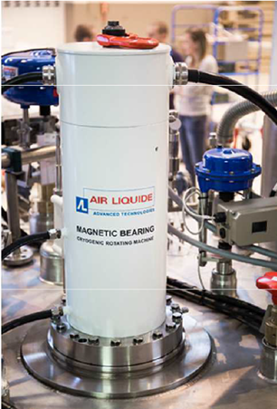
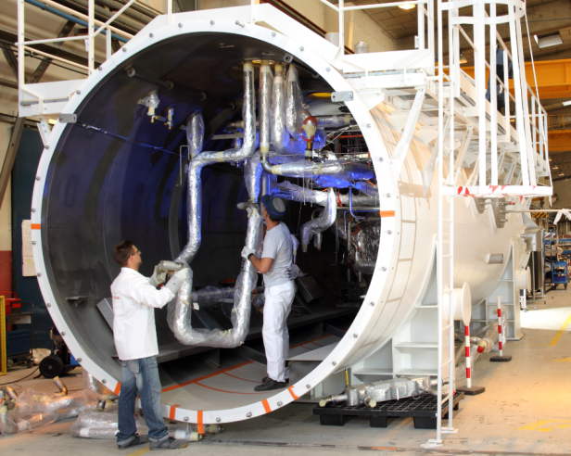
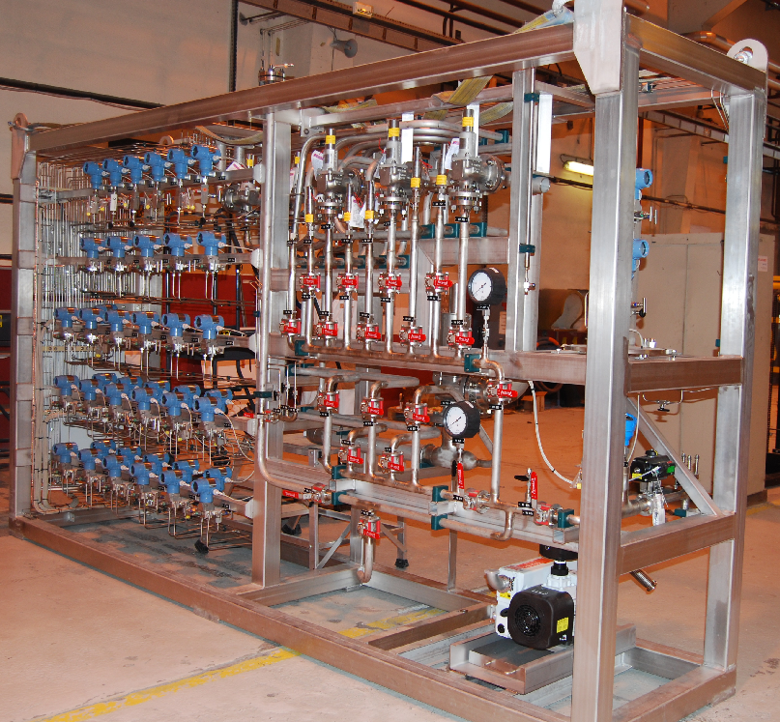
Equipment: Manufacturing at ALAT
Piping
Insulation
Cryogenic Rotating Machines
Cold Box Integration
Warm Panel Integration
Cold Box Integration

Slide 9
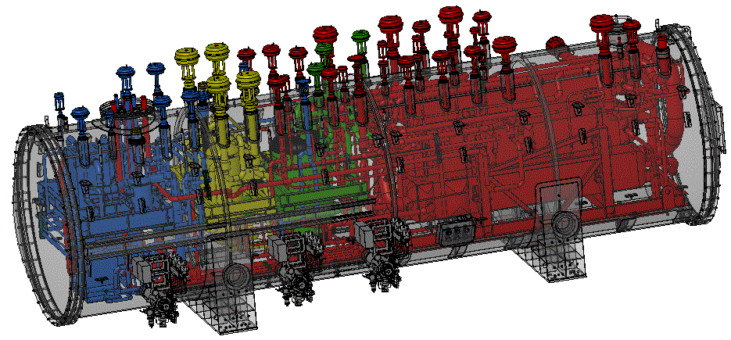
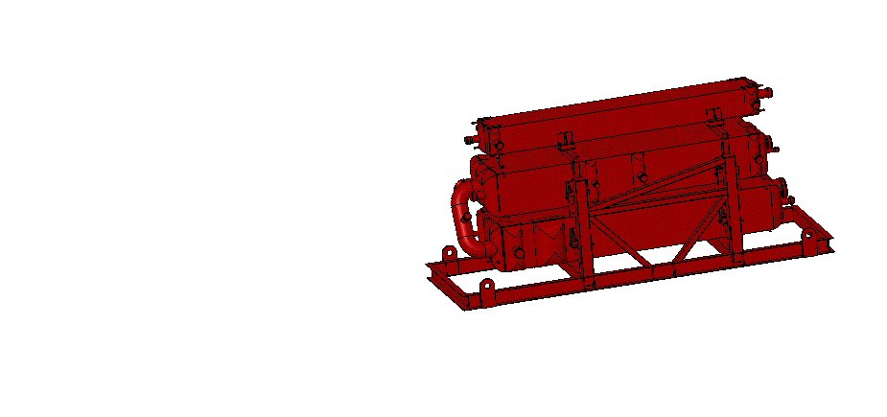
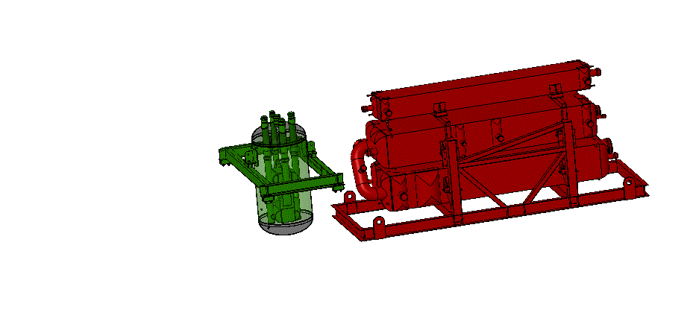
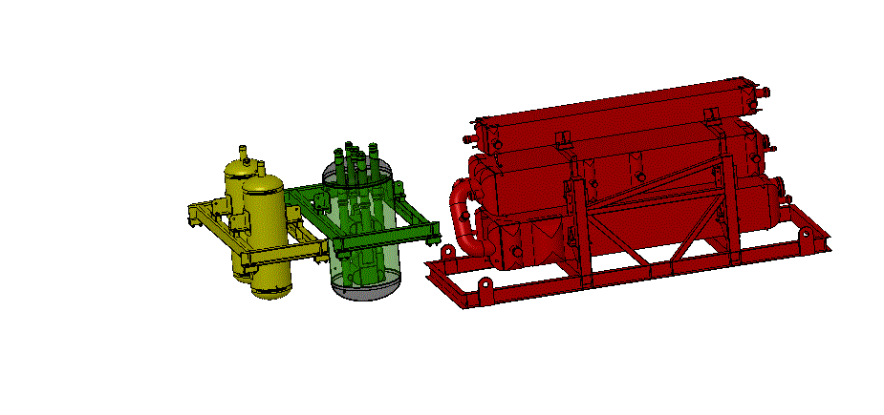
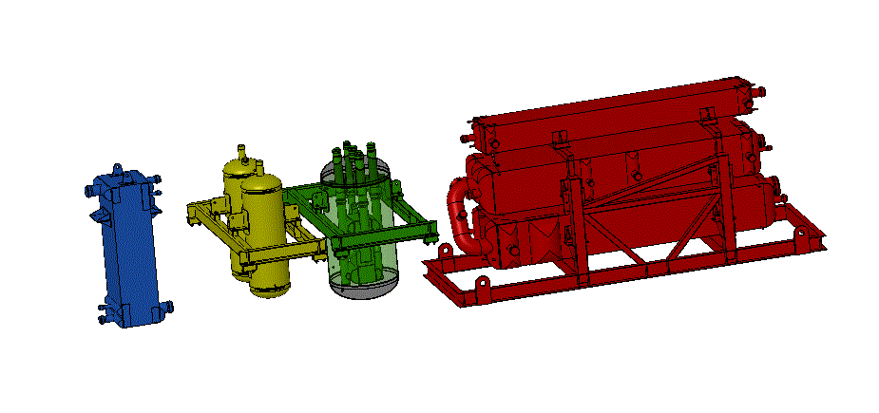

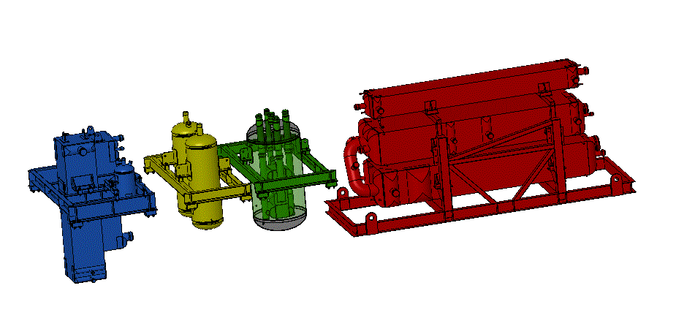
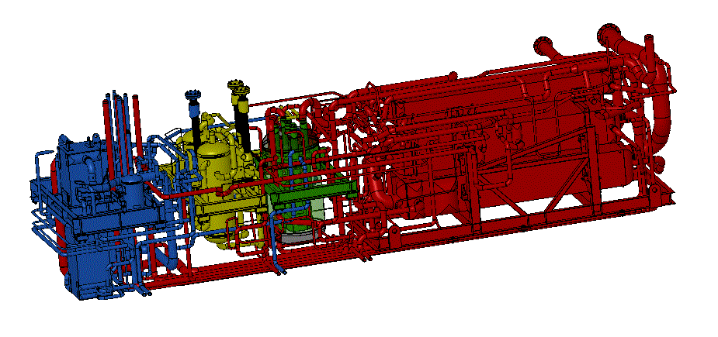
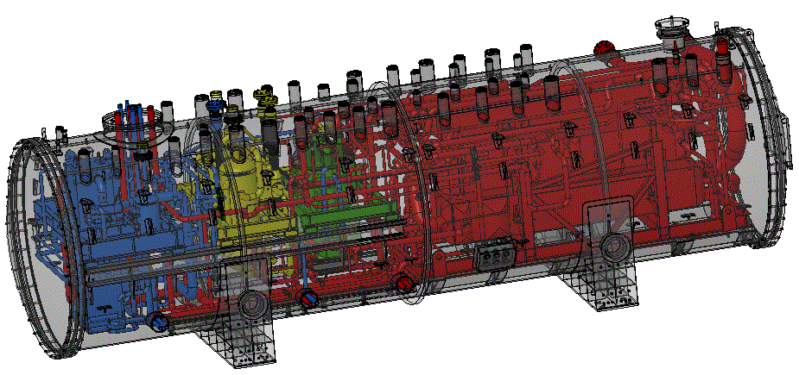
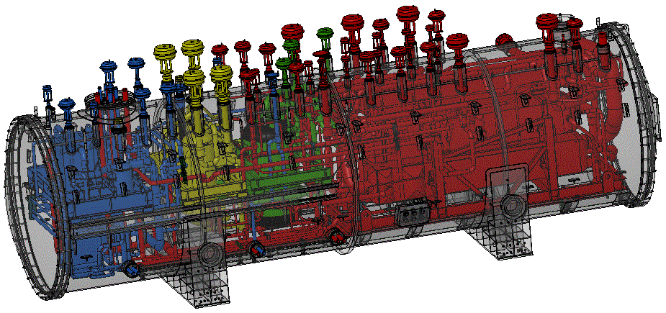
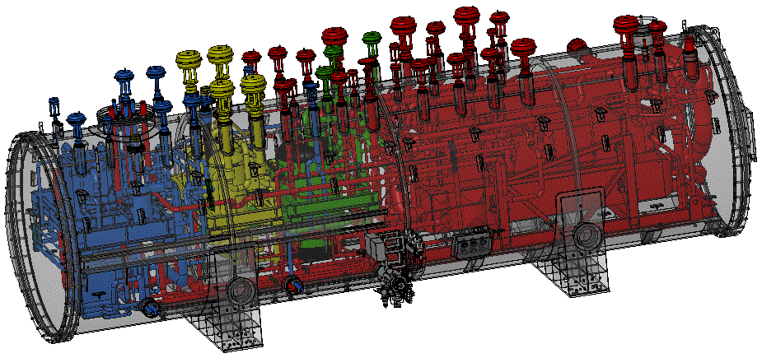

RCB Example – JT60SA
LN2 Phase Separator
(Could be replaced by 2 Turbines)
Main HX Battery
Cold HX + Ads.20K
Ads.80K
T1
T2
T3
Overall dimensions (Ø~3m, L~12m)

Slide 10
Possible Process to be challenged.

Slide 11
Comp. HP
ORS
Regul & cond.
Compr. VLP
300K -> 60K
60K -> 40K
40K -> 4,5K
~80K
~20K
Remove Impurities
Interface

Slide 12
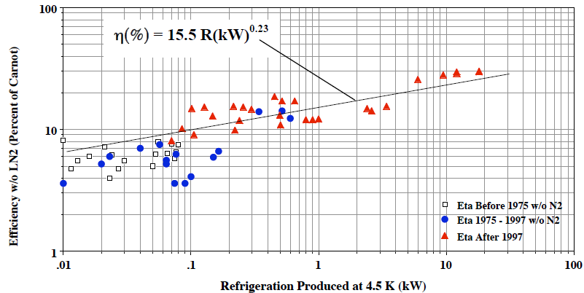
Carnot efficiency expectation shared by our customers
Michael Green published in 2008 the following curve
Nota: In all cases, there is no liquid nitrogen pre-cooling in the machines
Example of ESS bid : 9,1kW Eq @ 4,5K
Expected Carnot efficiency : 15,5*9,1^0,23 = 26%
Expected electrical power consumption → 2,3MW
ALAT proposal : 2,6MW (23% carnot efficiency)

Slide 13
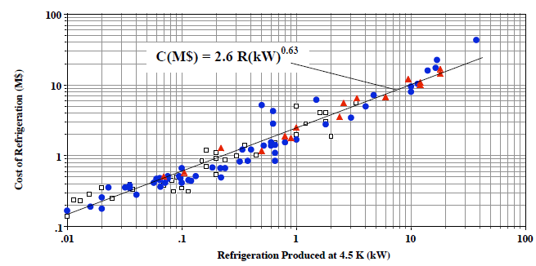
Price curve shared by our customers
Michael Green published in 2008 the following curve
Cost of Helium Refrigerators (cold boxes and compressors) versus Refrigeration at 4.5 K in 2007
For 9,1kW plant : 2,6*9,1^{0,65}= 10,5 M$ (2007)
Inflation since 2007 to 2015 : 12% -> 12 M$ ~12 M€ (2015)
To be added :test tools, capital spares, over cost due to VLP stage, control system → Total price ~ 12/0,75 ~ 16 M€

Slide 14
Electricity
(50 or 60Hz)
Lubrication
P₁
T₁
COMPRESS HELIUM
Hot MP GHe + oil
LP compressors
- Required volumetric Flow
- Pressure Ratio
- Electricity frequency (50/60Hz)
Volumetric flow capacity.
Efficiency (Electrical consumption).

Slide 15
Remove Oil From GHe
GN2
for initial conditioning
GHe
+ oil dropplets
+ oil vapour
COALESCERS
CHARCOAL TOWER
Ghe
+ [ H2O] = xx ppm
+ [ oil vapour] = 0
P3
T
GHe
+ oil vapour
Liquid Oil
Sizing/Selection Criteria
- Required volumetric Flow
- Pressure Ratio
- Electricity frequency (50/60Hz)
Performances
Volumetric flow
Efficiency (Electrical consumption).

Slide 16
Remove Oil From GHe
Hot MP GHe + oil
To primary separate oil from gas
Hot HP GHe
Hot MP GHe
Hot HP GHe + oil
1
Hot oil
Primary phase separators
To remove liquid oil from GHe
HP GHe
+ oil (vapor)
To remove oil vapor from GHe
HP GHe
HP GHe
+ oil (drops, vapor)
300K HP GHe
2
3
3-stage coalescers
Activated carbon filters
+ ORS final filters

