Slide 1
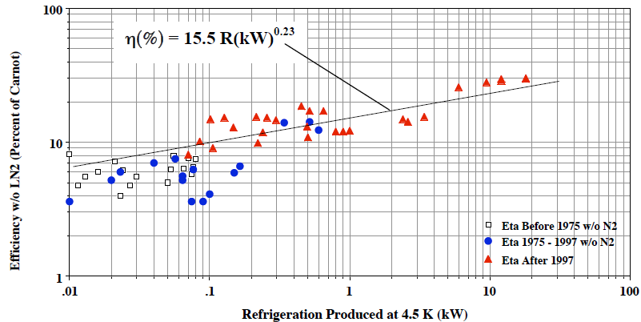
Carnot efficiency expectation shared by our customers
Michael Green published in 2008 the following curve
Nota: In all cases, there is no liquid nitrogen pre-cooling in the machines
Example of ESS bid : 9,1kW Eq @ 4,5K
Expected Carnot efficiency : 15,5*9,1^0,23 = 26%
Expected electrical power consumption → 2,3MW
ALAT proposal : 2,6MW (23% carnot efficiency)

Slide 2
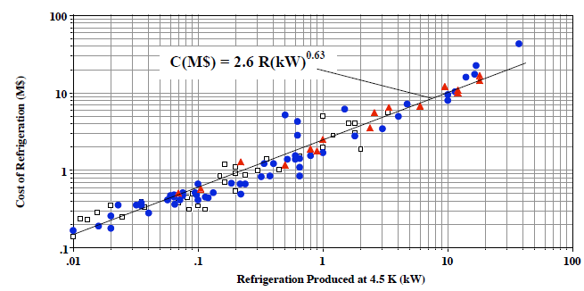
Price curve shared by our customers
Michael Green published in 2008 the following curve
Cost of Helium Refrigerators (cold boxes and compressors) versus Refrigeration at 4.5 K in 2007
For 9,1kW plant : 2,6*9,1^{0,65}= 10,5 M$ (2007)
Inflation since 2007 to 2015 : 12% -> 12 M$ ~12 M€ (2015)
To be added :test tools, capital spares, over cost due to VLP stage, control system → Total price ~ 12/0,75 ~ 16 M€

